Slide 1
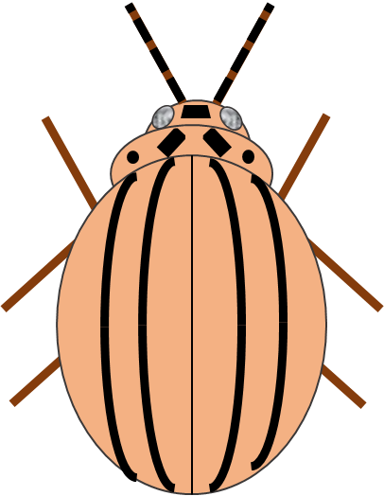
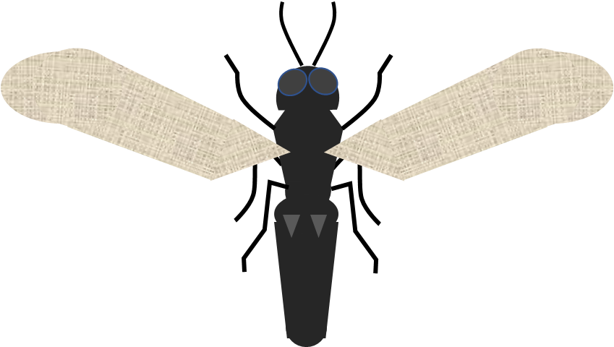
Potato Virus Management
Andrei Alyokhin
Applied Entomology
School of Biology and Ecology
The University of Maine
AndreiAlyokhin.com

Slide 2
Colonizing
aphids
Non-colonizing
aphids
Land
Probe
Settle
Feed
Reproduce
Land
Probe
Leave

Slide 3
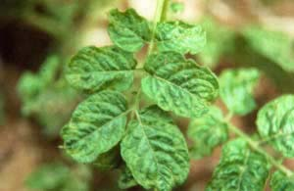
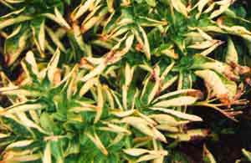
Colonizing
aphids
Non-colonizing
aphids
Land
Probe
Settle
Feed
Reproduce
Land
Probe
Leave
Potato Virus Y
Potato Leafroll Virus
Potato Virus Y

Slide 5
PLRV
and
PVY
Colonizing vectors
(green peach, potato, and buckthorn aphids)

Slide 6
PVY
Non-colonizing vectors
(any aphid species)

Slide 7
Planting virus-free seed is essential for controlling both PLRV and PVY

Slide 8
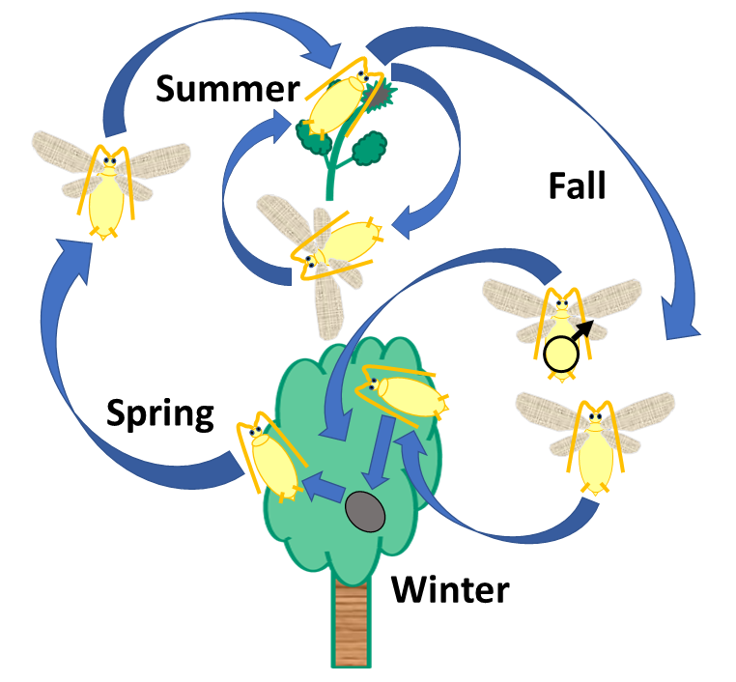
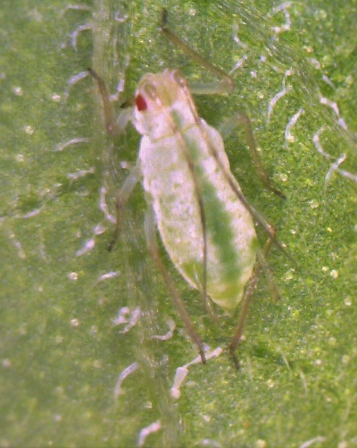
Buckthorn
aphid
Potato
aphid
Colonizing aphids spread PLRV (exclusively) and PVY (to some extent)
Green peach
aphid
Potato Virus Y
Potato Leafroll Virus

Slide 9
Buckthorn
aphid
Potato
aphid
Colonizing aphids can live on several hundred species of plants
Green peach
aphid
Potato Virus Y
Potato Leafroll Virus

Slide 10
Insecticides suppress PLRV by killing off its colonizing aphid vectors

Slide 11
Insecticides suppress PLRV by killing off its colonizing aphid vectors

Slide 12
Insecticides suppress PLRV by killing off its colonizing aphid vectors

Slide 13
Green peach
aphid
…but insecticide resistance can be an issue
Alyokhin, A., Y.H. Chen, M. Udalov, G. Benkovskaya, and L. Lindström. 2022. Evolutionary considerations in potato pest management. In: Alyokhin, A., S.I. Rondon, and Y. Gao [editors]. Insect Pests of Potato: Global Perspectives on Biology and Management. Second Edition. Academic Press, Oxford, UK. Pp. 429-450.

Slide 14
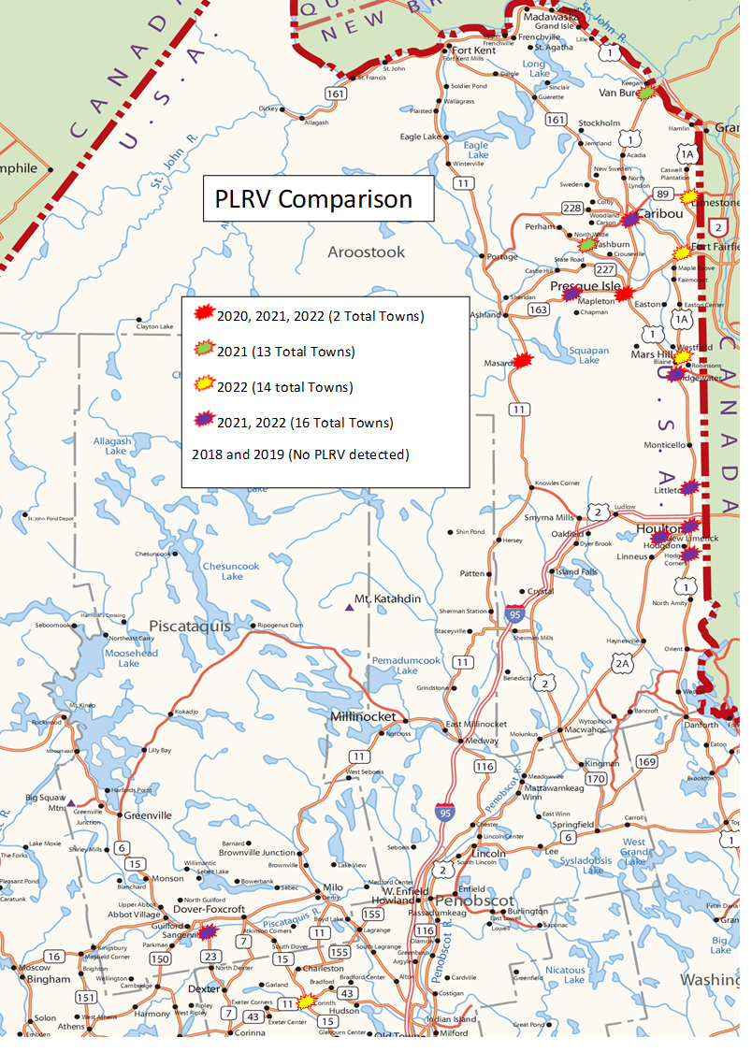
Incidence of PLRV in Maine over the Last Five Years

Slide 15
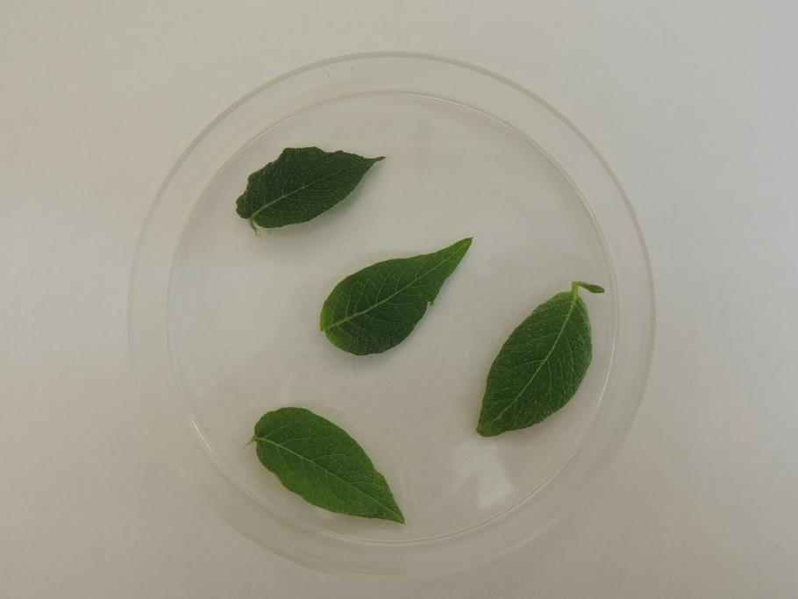
Green peach
aphid

Slide 17
Colonizing
aphids
Non-colonizing
aphids
Land
Probe
Settle
Feed
Reproduce
Land
Probe
Leave

Slide 18
Colonizing
aphids
Non-colonizing
aphids
Land
Probe
Settle
Feed
Reproduce
Land
Probe
Leave
Do not spend long enough time on potatoes to be killed by insecticides

Slide 19
To the contrary, intoxication may lead to excitation and erratic movements.

Slide 21
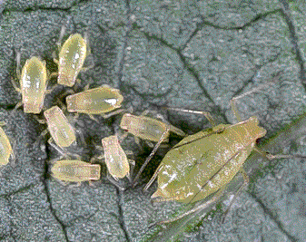
Oil Sprays
Margaritopoulos et al. 2010. Journal of Applied Entomology 134: 323–332.

Slide 22
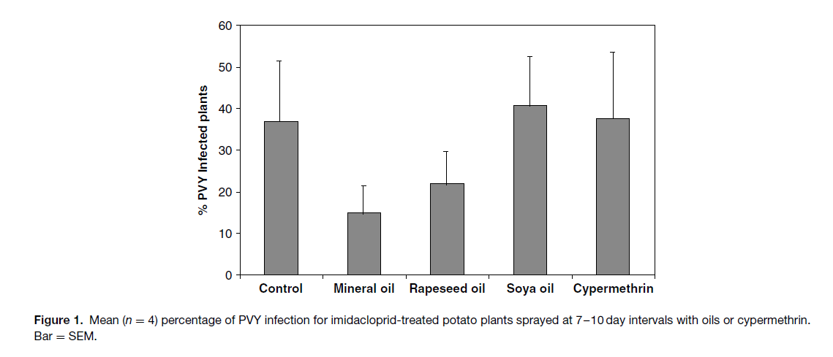
Oil Sprays
Martin-Lopez, B. et al. 2006. Pest Manag. Sci. 62: 372–378.

Slide 23
Crop Borders

Slide 24
Crop Borders

Slide 26
Crop Borders

Slide 27
Crop Borders

Slide 28
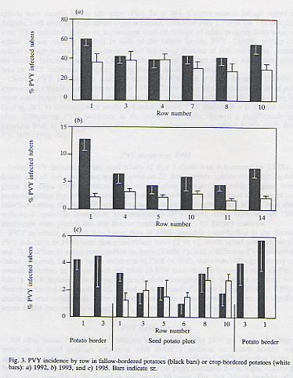
Crop Borders
DiFonzo et al. 1996. Annals of Applied Biology 129: 289–302.

Slide 29
Crop Borders
To be effective, plant species grown as crop
borders should:
Not be PVY hosts
Not support substantial aphid populations
Remain green throughout the season

Slide 30
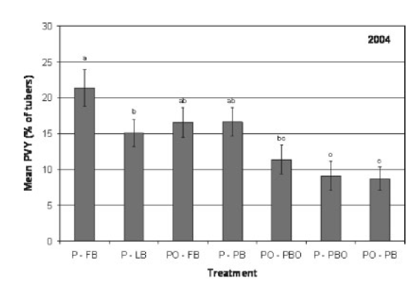
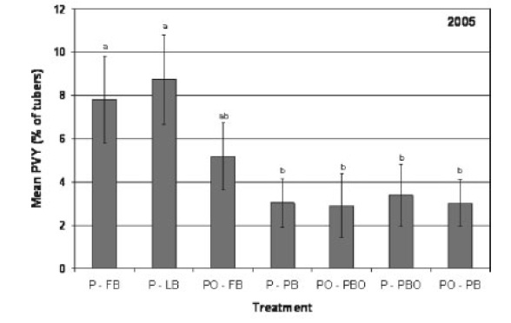
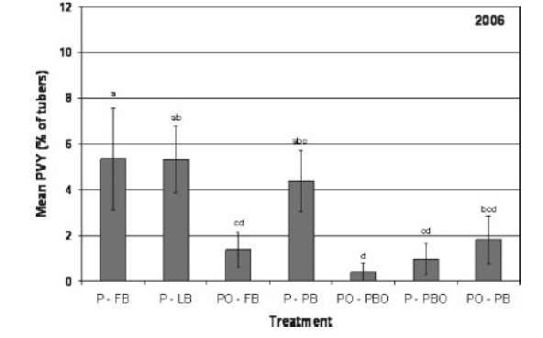
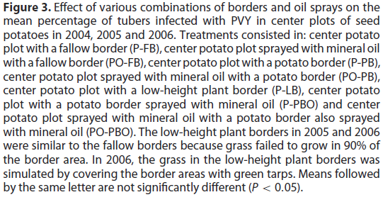
Combining Oil Sprays with Crop Borders
Boiteau, G., M. Singh, and J. Lavoie. 2009. Pest Manag. Sci. 65: 255–259.

Slide 31
Area-Wide Management
Viruses need to be managed effectively on neighboring fields regardless of the crop destination (processing, tablestock, or seed) and ownership.

Slide 32
Area-Wide Management

Slide 33
Area-Wide Management

Slide 34
Area-Wide Management

Slide 35
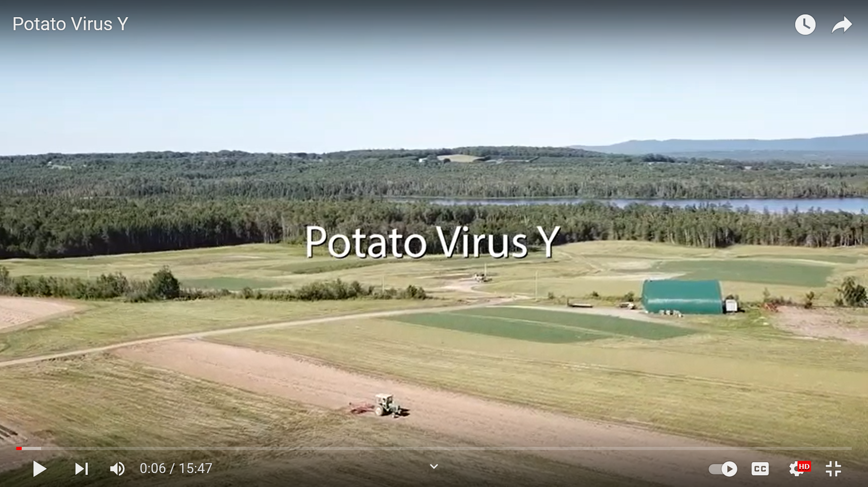
https://youtu.be/ZX0r0GqcYsE

Slide 36
Alyokhin, A., S.I. Rondon, and Y. Gao [editors]. 2022. Insect Pests of Potato: Global Perspectives on Biology and Management. Second Edition. Academic Press, Oxford, UK.

