Slide 1
Powdery Scab Management
Ibrahim Kutay Ozturk, Ph.D.
Extension Potato Pathologist
University of Maine Cooperative Extension
Maine Potato Summit - January 4th, 2024
University of Maine Cooperative Extension
Aroostook County – Presque Isle
57 Houlton Rd
Presque Isle, ME 04769
207.764.3361 • ibrahim.ozturk@maine.edu
The University of Maine is an equal opportunity/affirmative action institution.

Slide 2
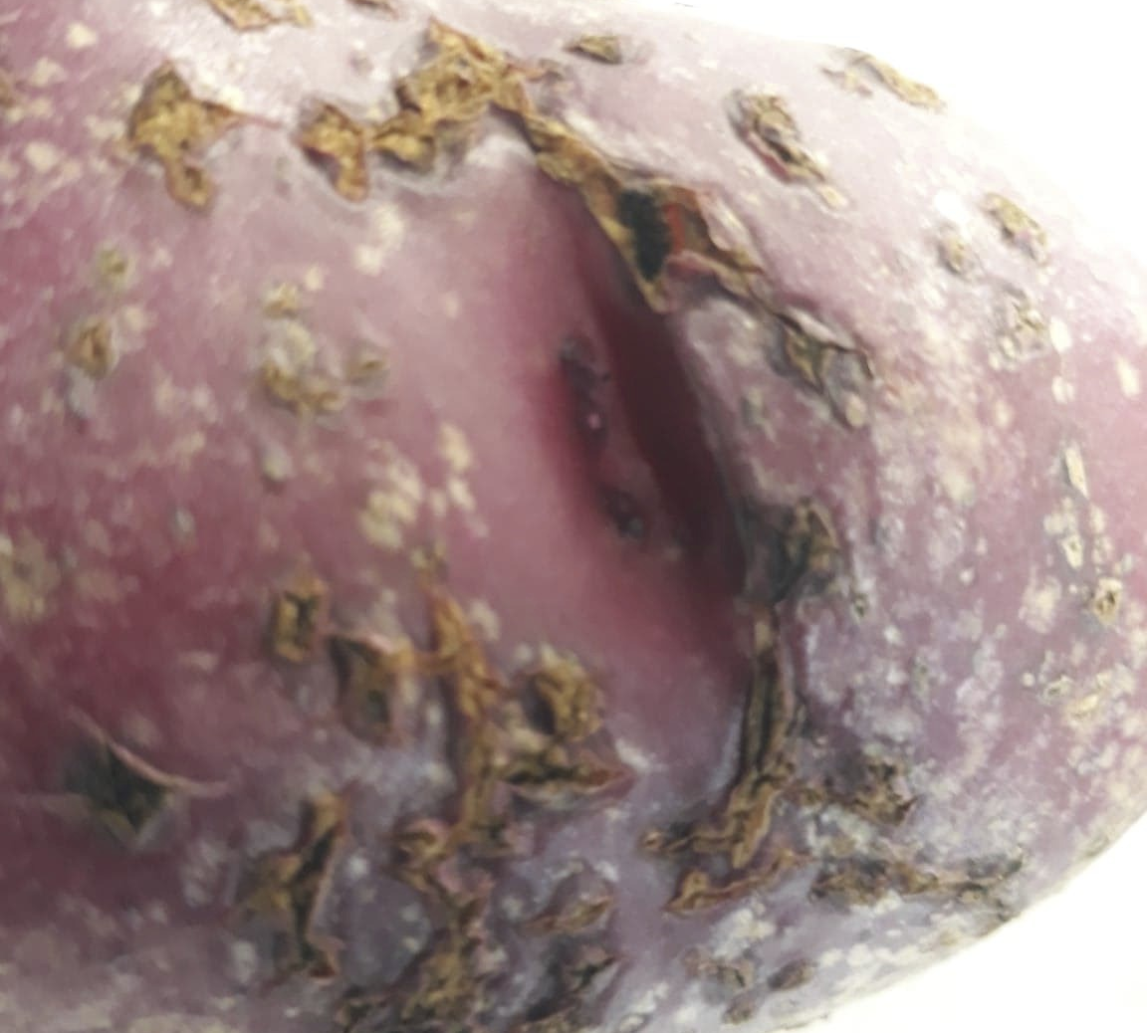
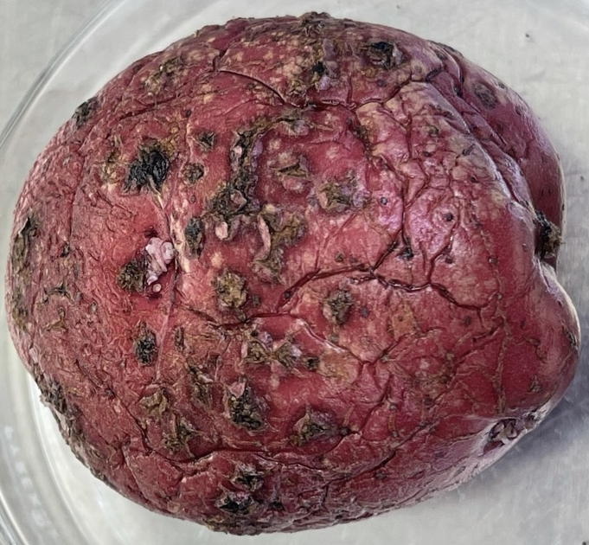
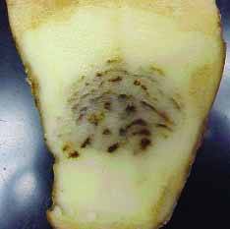
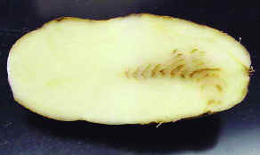
Powdery Scab & Potato Mop-Top Virus
Photos: University of Maine Cooperative Extension
Notes:
Bu size tanidik geliyor mu, ekonomik bilgi ver complex hastalik oldugunu soyle
Tarlanizda gormuyorsaniz da guvende degilsiniz, cunku asemptomatik olarak da ciddi problemlere neden olabiliyor. Sunumumda bunun detaylarini vericem

Slide 3
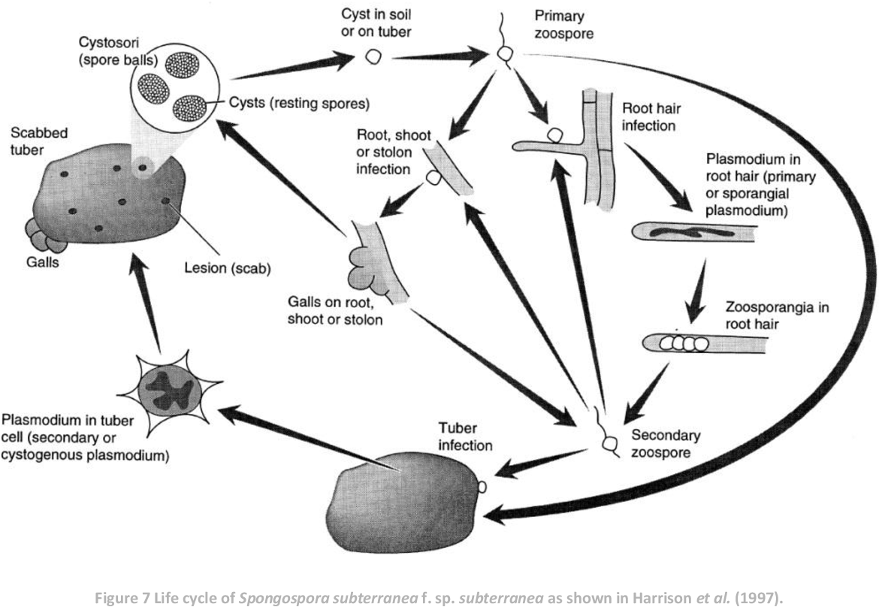
Lifecycle of Powdery Scab Pathogen Spongospora subterranea
Can survive for decades
Harrison et al. (1997), Plant Pathology
Falloon et al. (2016), Plant Pathology
Notes:
Sss general info – soilborne protist
When it was first discovered, where has it been seen
How does it cause the disease (lifecycle) – connect with we don’t know much on this disease because it is a challenging organism to work with.
Because it impacts different aspects of the plants differently

Slide 4
Impact of the Powdery Scab Pathogen
Vector of Potato Mop-Top Virus
Root Pathogen
…AND
Indirect impacts
Tuber Pathogen
Photos: University of Maine Cooperative Extension

Slide 5
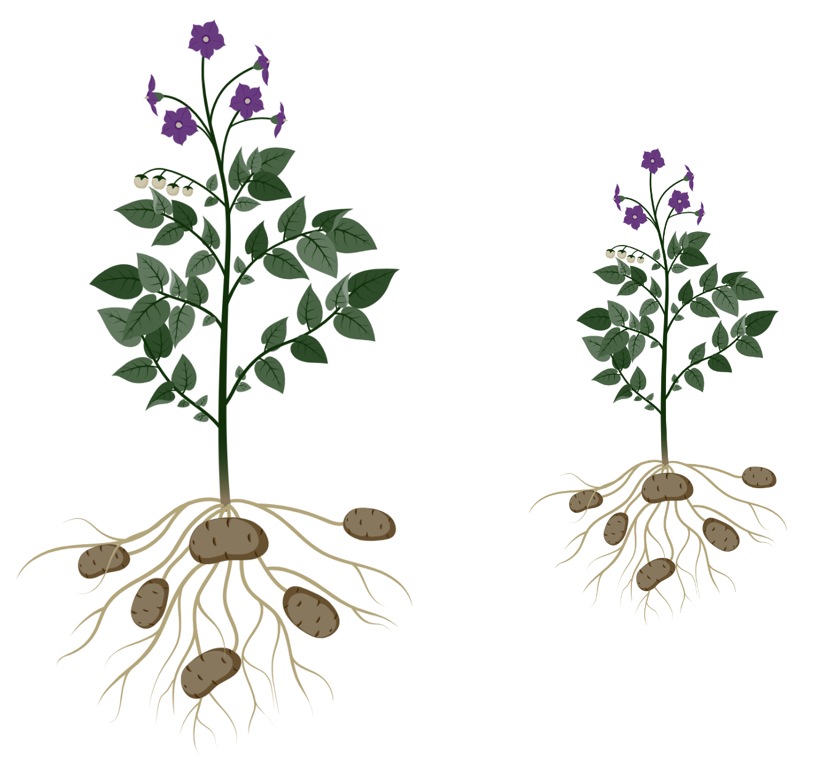
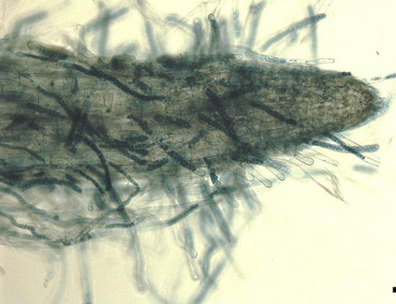
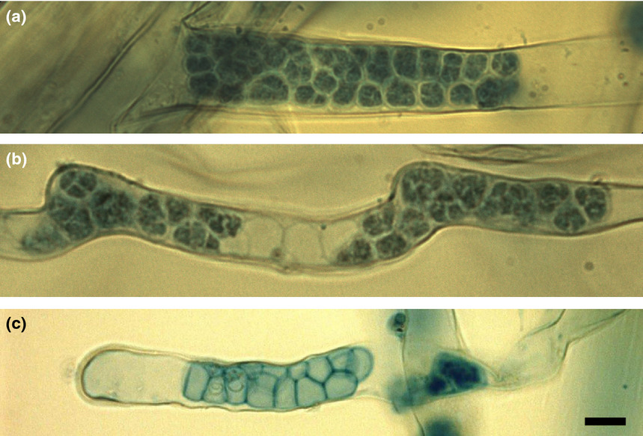
As a Root Pathogen
Root galls
Plant Growth
Falloon et al. (2016), Plant Pathology
Water Uptake
Notes:
Root impacts – include overall plant growth impacts
Tuber impacts
Vector of PMTV
My findings on asymptomatic tubers and secondary infections

Slide 6
As a Tuber Pathogen
Unmarketable fresh product
Yield
Processing costs

Slide 7
As a Vector, and Source of Other Problems…
Vectors PMTV:
Spraing/necrosis
Yield (up to 67%)
Risk of soil and storage diseases of tubers (i.e., late blight, fusarium dry rot etc.)
Also…
Photos: University of Maine Cooperative Extension

Slide 8
Powdery Scab (Sss) Can Increase Severity of Subsequent Infections of Late Blight and Stem Rot Above Ground
Ozturk et al. (In preparation)
ATL: Atlantic, DRN: Dark Red Norland, GDR: GoldRush,
LMK: Lamoka, SLV: Silverton, SNO: Snowden
Notes:
`

Slide 9
Powdery scab is a complicated problem How do we manage it?
Cultural control – Most effective
Less susceptible varieties – Somewhat effective
Chemical control – Ineffective, but could this change?

Slide 10
Cultural Control
Improve drainage
Avoid using manure from animals that were fed with infected potatoes
Avoid excessive fertilization
Do not plant infected seeds

Slide 11
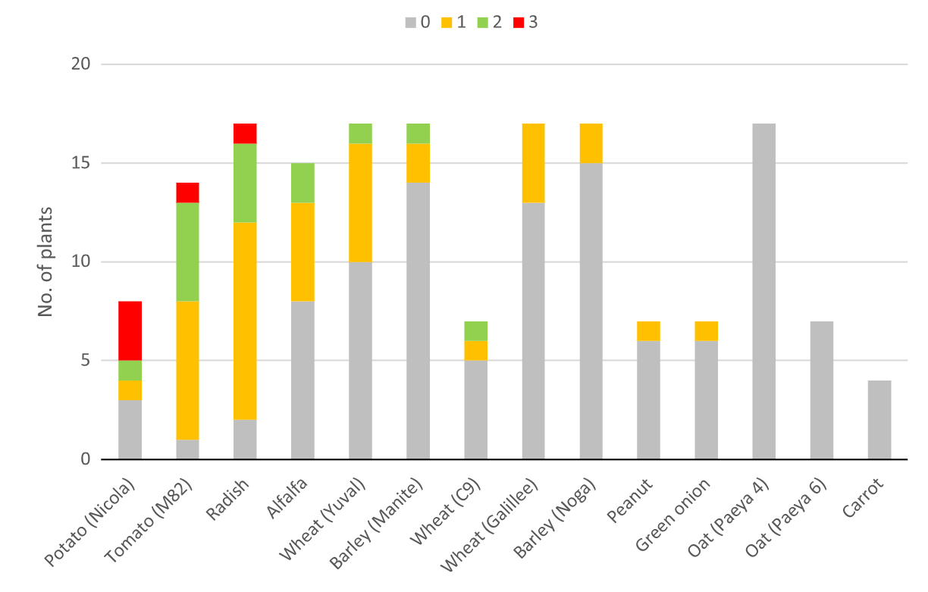
Crop Rotation
0-3: Sss disease severity ratings
Critical but difficult – wide host range:
Wheat
Barley
Broccoli
Alfalfa
Radish
Tomato
Large number of weed species
Oats and carrot are good rotation options
Tsror et al. (2020), Plant Pathology
Notes:
Majority of commercially available potato varieties are susceptible to some degree to Sss, and no immune commercial variety is available to this date (Merz et al. 2012, Bitarra et al. 2016, Zeng et al. 2020). Accurate reporting of varieties’ susceptibilities to Sss is essential to provide correct recommendations to growers. However, discrepancies in the resistance reports are present in the literature (Falloon et al. 2016, Bitarra et al. 2016). Even though discrepancies in the resistance reports were previously attributed to the variations between the resistance ratings in the past (Merz et al. 2012 ), differences in the environmental conditions such as temperature and water saturation are important factors that might explain some of these discrepancies (Van de Graaf et al. 2005; 2007).
This is what Merz paper says, however when I compare the Bitarra and Falloon paper, but I don’t completely agree and I added another sentence as my own comment to other potential impacts. Because here are two examples;
On Russet Burbank:
Falloon paper: Moderate root dysfunction, moderate root hyperplasia, ‘moderately resistant’ to powdery scab
Bitarra paper: Moderate root galls and very resistant to powdery scab
On Ranger Russet:
Falloon paper: severe root dysfunction, light root hyperplasia, ‘moderately resistant’ to powdery scab
Bitarra paper: Very resistant to both
One thing that stroke me was the Bitarra field experiment was carried out in June-October while Falloon experiment was carried out in greenhouse conditions at 16±2 C, which surely had a big impact as we know temperature is critical. Also makes sense for these 2 examples on why Bitarra has reported the higher resistance ratings because of the high temperature.

Slide 12
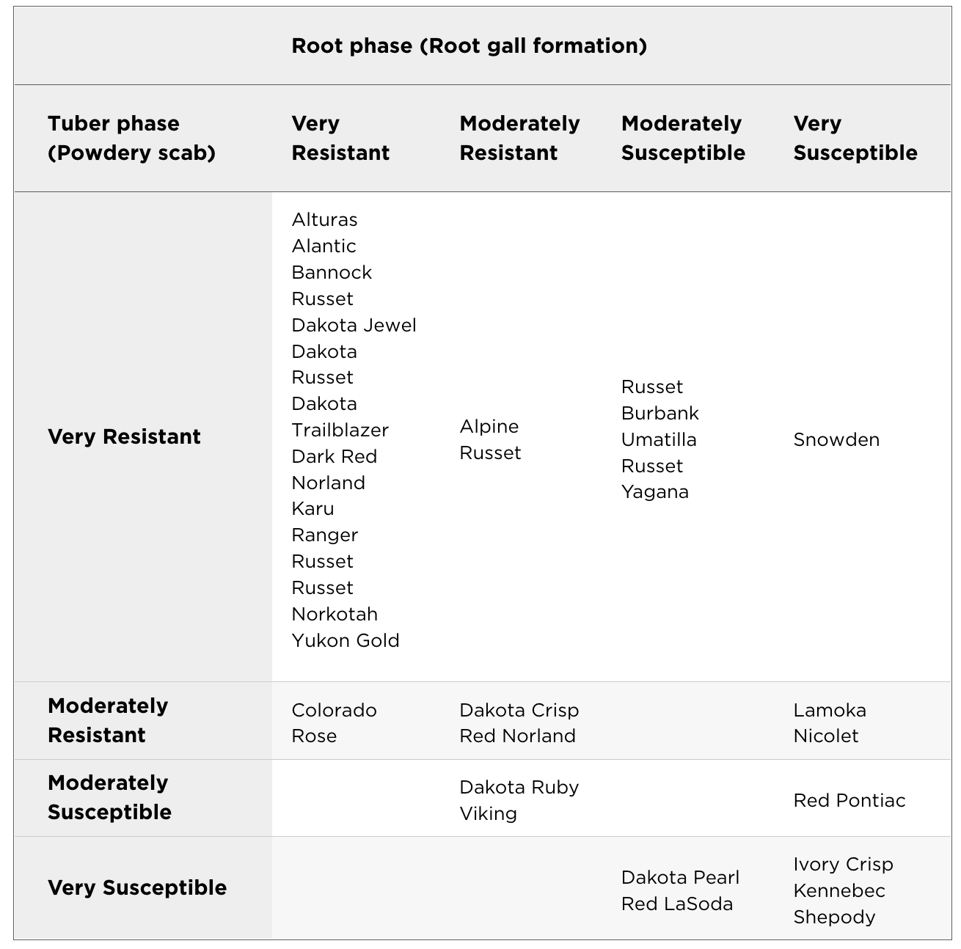
Selecting the Right Varieties
Bittara et al. (2016), Am. J. Potato Res.
Ozturk et al. (In preparation)

Slide 13
Chemical Control
Not very effective:
In-furrow treatment of zinc oxide (ZnO) and zinc sulfate (ZnSO₄)
Preplant chemigation with metam sodium and chloropicrin - plastic cover
Showed limited efficacy
Inoculum recovery next season
Environmental considerations
High cost
Developments on new control methods e.g., germinate to exterminate & zoospore blinding

Slide 14
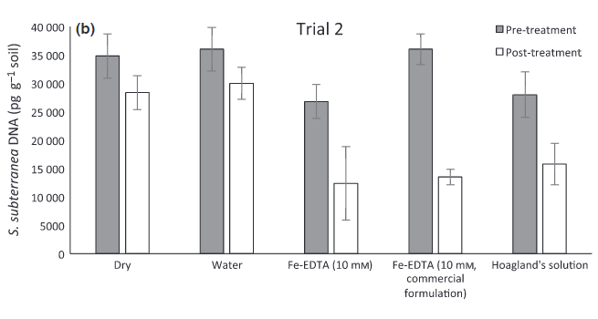
*Each treatment was applied to the soil six times within 34 days
Balendres et al. (2018), Plant Pathology
Notes:
Each treatment was applied to the soil six times within 34 days.

Slide 15
Conclusion
Curative methods e.g. fumigants: Limited effect & impractical
No immune potato variety, but some are less susceptible (Atlantic, Yukon Gold, Ranger Russet etc.)
Effective preventive methods:
Crop rotation (oats, carrots)
Soil drainage
Avoiding the spread of the diseased material
Avoiding overfertilization

Slide 16
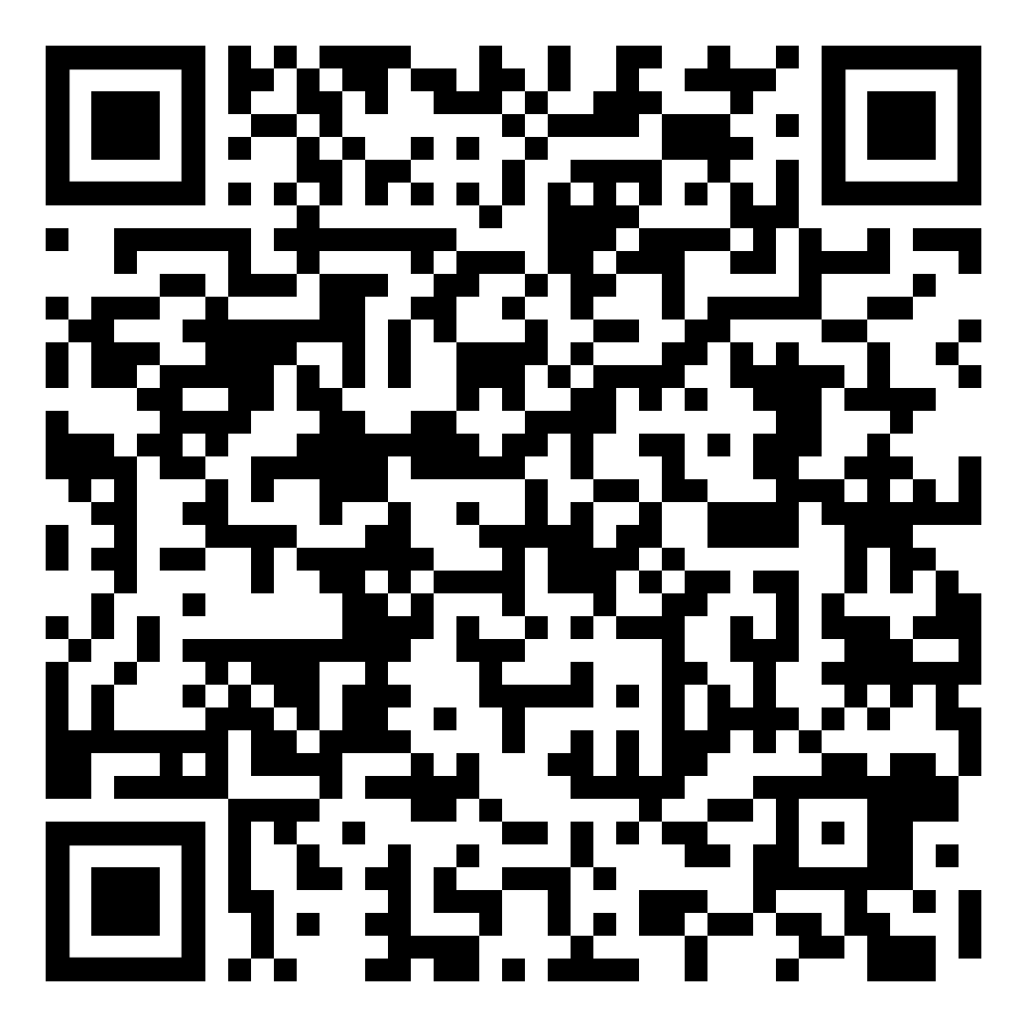
For more information, please reach out ibrahim.ozturk@maine.edu
University of Maine Cooperative Extension: (207)764-3361
Powdery Scab Factsheet
Grower Survey – Only 5 minutes!

