Slide 1
How Much Pesticide is on My Plate?
Jeff Miller

Slide 4
The Dirty Dozen

Slide 5
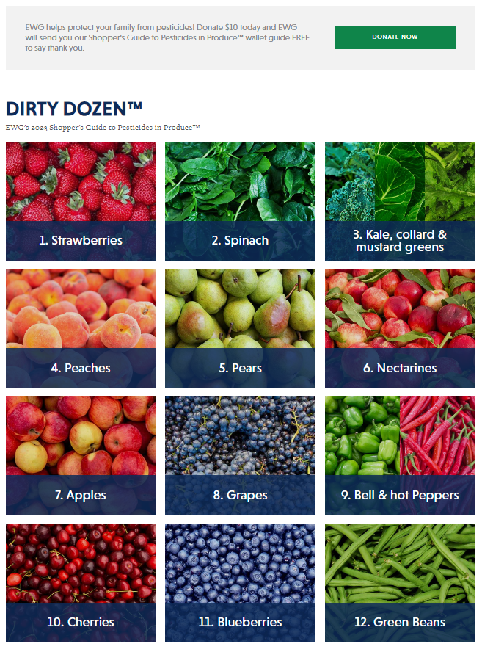
The Dirty Dozen
https://www.ewg.org/foodnews/dirty-dozen.php

Slide 6
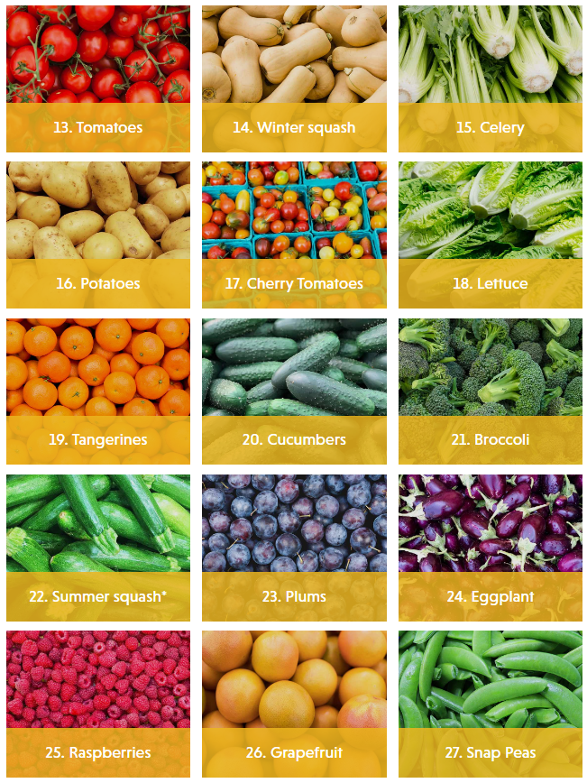
The Dirty Dozen (+ a few more)
https://www.ewg.org/foodnews/full-list.php

Slide 7
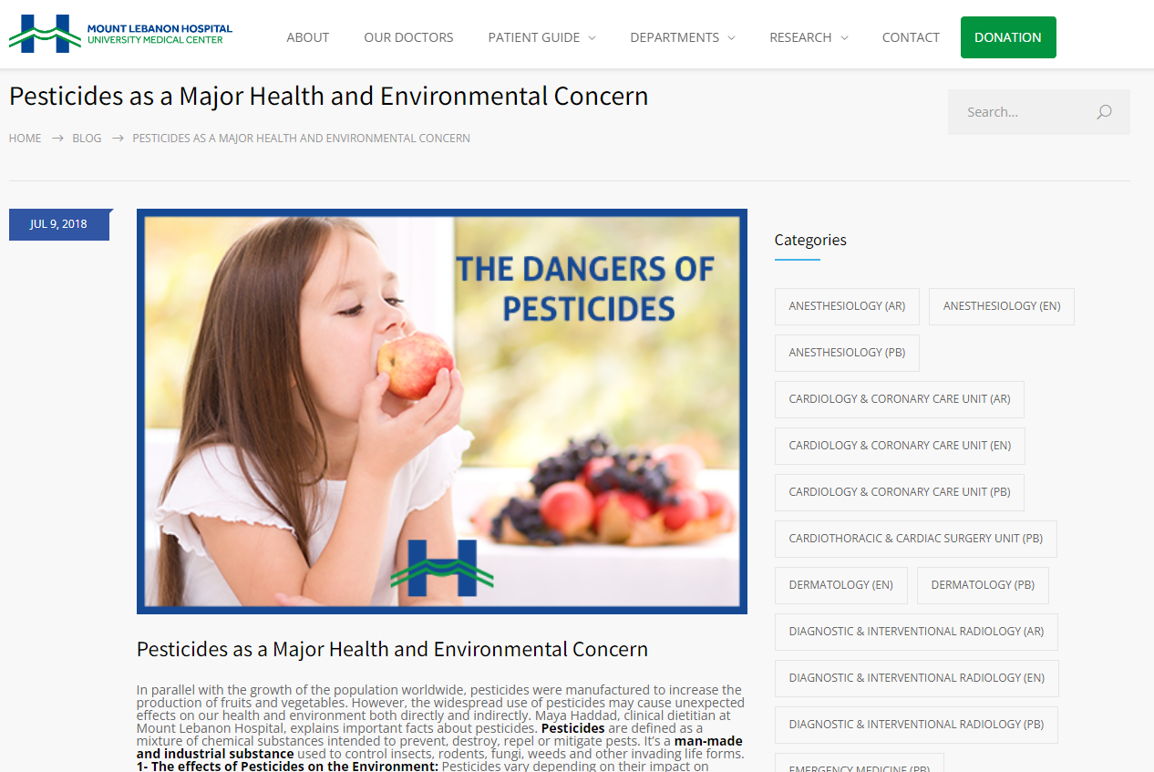
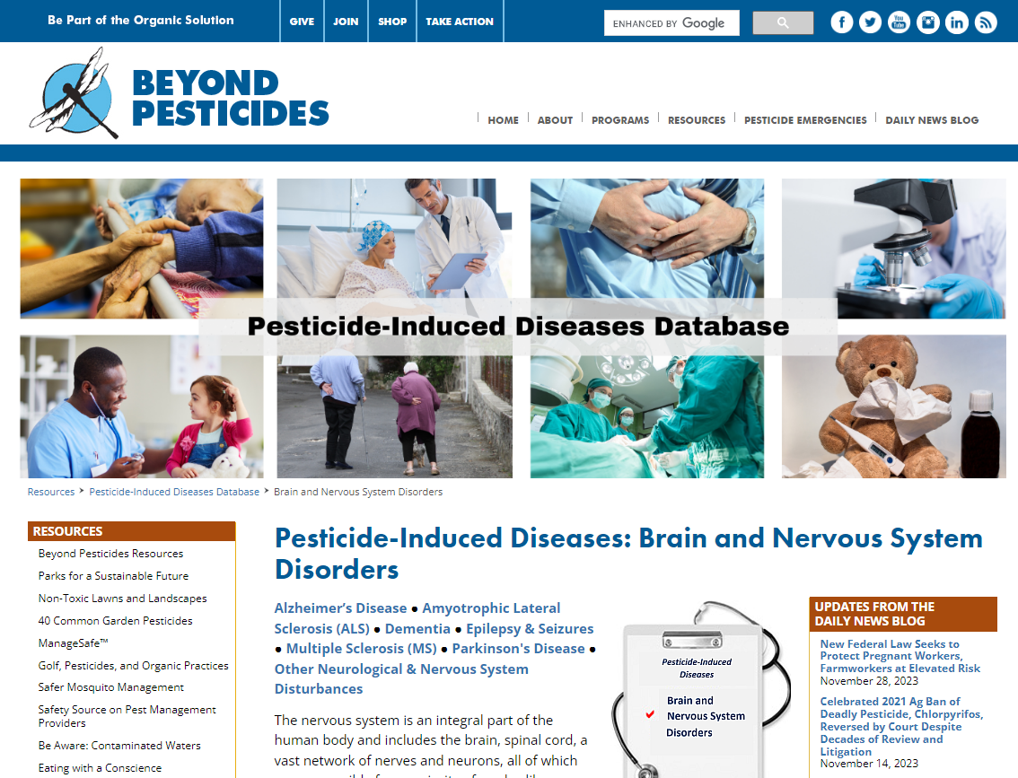
https://www.mlh.com.lb/pesticides-as-a-major-health-and-environmental-concern/
https://www.beyondpesticides.org/resources/pesticide-induced-diseases-database/brain-and-nervous-system-disorders

Slide 8
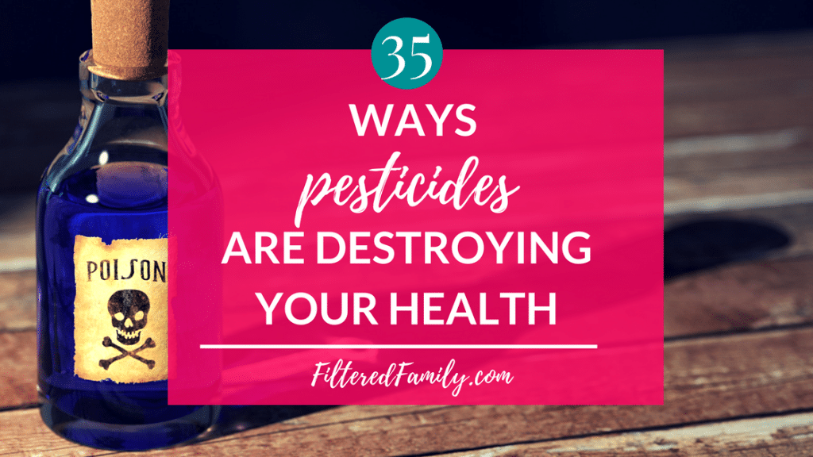
http://www.filteredfamily.com/the-dangers-of-pesticides/

Slide 9
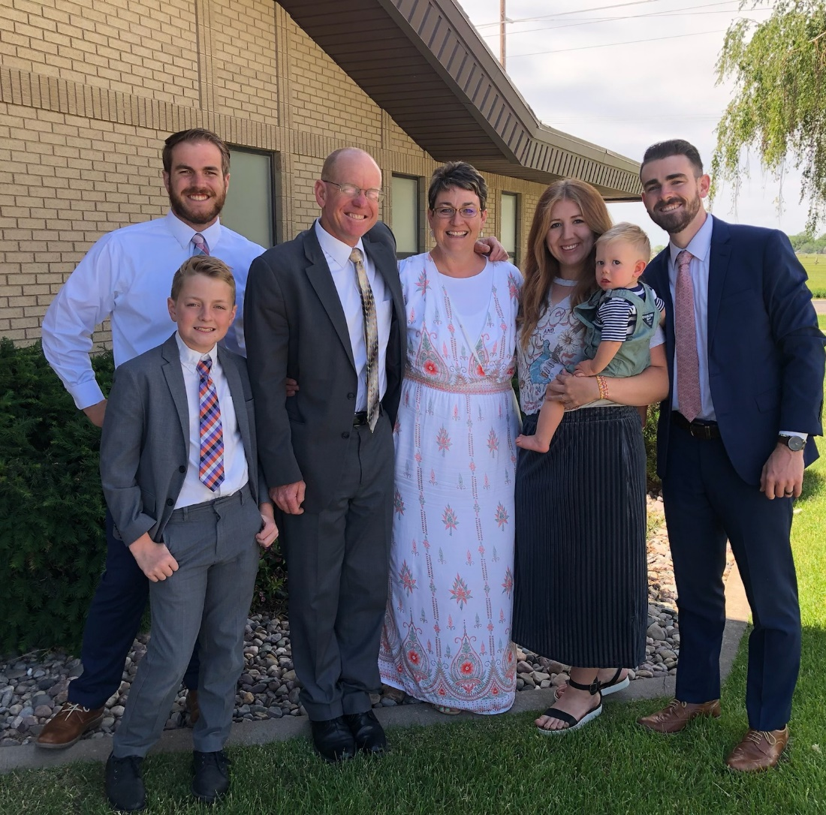
What is the true risk of pesticides in our food?

Slide 10
Food Quality Protection Act (FQPA) - 1996
Focus on protecting human health, environment.
“Reasonable certainty of no harm”
Increased scrutiny of effects on children (10x safety factor).
Consider aggregate risk from multiple sources.
Registration review every 15 years.

Slide 11
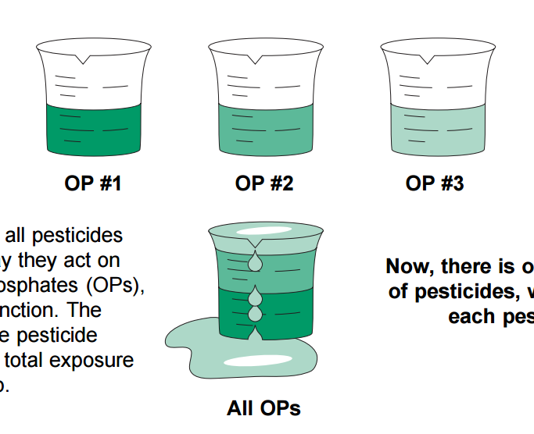
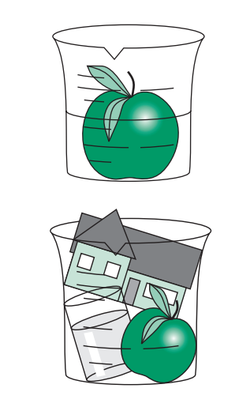
Setting Risk Tolerances Under FQPA
Residue Tolerances
Risk Exposure
Pre-FQPA
Post-FQPA
Adapted from FQPA: The Food Quality Protection Act, NC State University, AG-609

Slide 12
FQPA Product Reregistration Status
Re-registered | 5,121
Amended | 3,491
Canceled | 11,702
Suspended | 40
Total products completed | 20,354
Products pending action | 4,621
Data as of FY2016
https://www.epa.gov/pesticide-reevaluation/reregistration-and-other-review-programs-predating-pesticide-registration

Slide 13
EPA Tolerance for Pesticides
NOAEL = No Observable Adverse Effect Level
ADI = Acceptable Daily Intake
Lowest NOAEL of most sensitive test
ADI often = NOAEL divided by safety factor (100 or 1000)
Includes all circumstances of dietary exposure
EPA assumes highest label usage

Slide 14
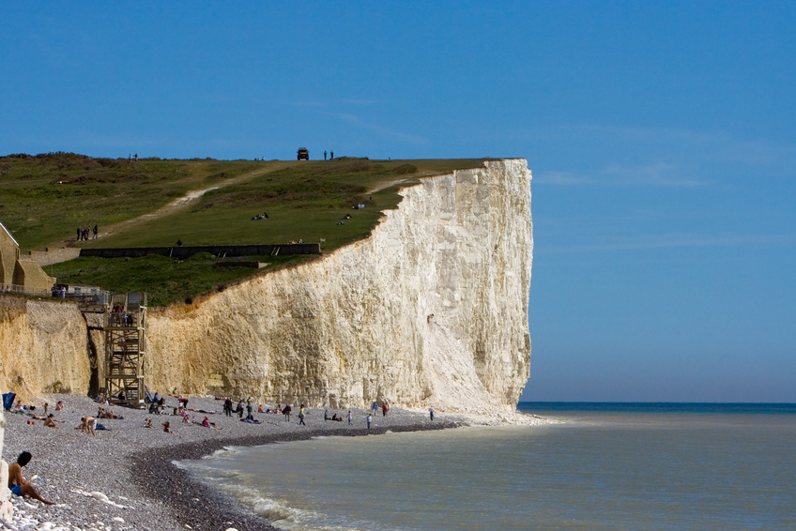
NOAEL
ADI
NOAEL

Slide 15
Pesticide Labels
When used according to the label, pesticides will not cause unreasonable harm to the environment.
The label is the law as to how a product can be used.

Slide 16
ADI
ADI
NOAEL
Product use according to label

Slide 17
USDA-ARS Pesticide Data Program
Started in 1991
Focus on infants and children
~600 sites
Test for 450 pesticides, breakdown products
~10,000 samples collected/year
2020 Samples
Fresh and processed fruits and vegetables

Slide 18
Summary of Pesticide Data Program
 | 2015 | 2016 | 2017 | 2018 | 2019 | 2020 | 2021
Samples | 10,187 | 10,365 | 10,541 | 10,545 | 9,697 | 9,600 | 10,127
% No Detections | 15 | 23 | 53 | 48 | 42.5 | 30.0 | 24.0
% Below Tolerance | >99 | >99 | >99 | >99 | 99 | >99 | >99
% Above Tolerance | 0.53 | 0.46 | 0.59 | 0.78 | 1.29 | 0.49 | 0.53
% W/O Tolerance | 3.9 | 2.6 | 3.3 | 6.1 | 8.2 | 3.2 | 3.7

Slide 19
Detection of Pesticides
1950 = 1 ppm
1965 = 0.001 ppm (1 ppb)
1975 = 0.000001 ppm (1 ppt)
2005 = 0.000000001 ppm (1 ppq)
ppm = 1 ml/L or 1 mg/kg
1 inch in 16 miles
1 second in 11.5 days
1 minute in two years
ppb = 1 µl/L or 1 µg/kg
1 second in 32 years
1 sheet of toilet paper in a roll stretching from New York to London
1 silver dollar in a roll stretching from Detroit to Salt Lake City
1 drop of water in an Olympic size swimming pool

Slide 20
PDP 2016 – Potato Residues
Active Ingredient | # Detects | % Detects | Lowest Detect (ppm) | Highest Detect (ppm) | EPA Tolerance
Azoxystrobin | 197 | 27.8 | 0.002 | 1.2 | 8.0
Boscalid | 138 | 19.5 | 0.003 | 0.034 | 0.05
Chlorpropham | 705 | 99.6 | 0.002 | 10 | 30
Clothianidin | 94 | 13.3 | 0.003 | 0.032 | 0.3
Difenoconazole | 81 | 11.4 | 0.002 | 1.8 | 4.0
Fludioxonil | 66 | 9.3 | 0.2 | 0.93 | 6.0
Imidacloprid | 301 | 42.5 | 0.002 | 0.11 | 0.40
Metalaxyl/Mefenoxam | 54 | 7.6 | 0.002 | 0.017 | 0.5
Thiabendazole | 47 | 6.6 | 0.002 | 3.1 | 10.0
Potatoes: May 91 – Dec 95
Dec 96 – Dec 97
Jul 00 – Jun 02
Jan 08 – Dec 09
Jan 15 – Dec 16
Apr 22 – Ongoing
708 total samples.
None exceeded tolerance.

Slide 21
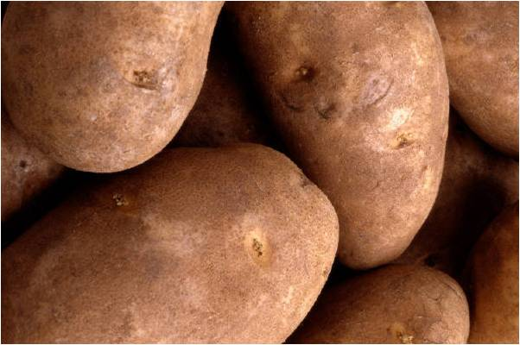
PDP Residues - Potatoes
EPA Tolerance
Highest Detection

Slide 22
These data only relate to the presence of pesticide residue, NOT amount.
The assumption is that any pesticide residue is bad.
www.ewg.org

Slide 23
“All substances are poisons; there is none which is not a poison. The right dose differentiates poison from remedy.”
- Paracelsus
Taken from Casarett & Doull’s Toxicology: The Basic Science of Poisons.

Slide 24
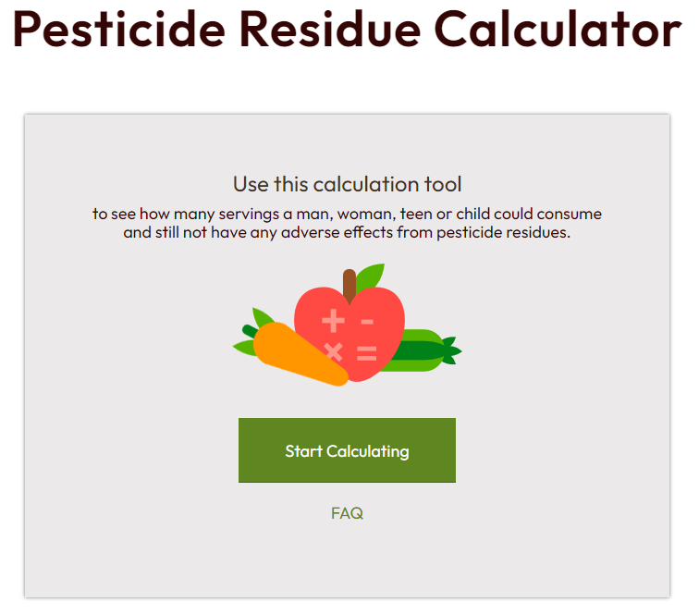

Slide 25
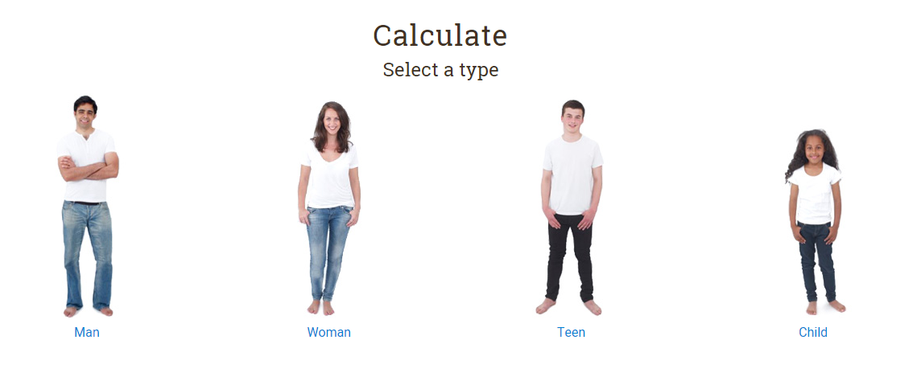

Slide 26
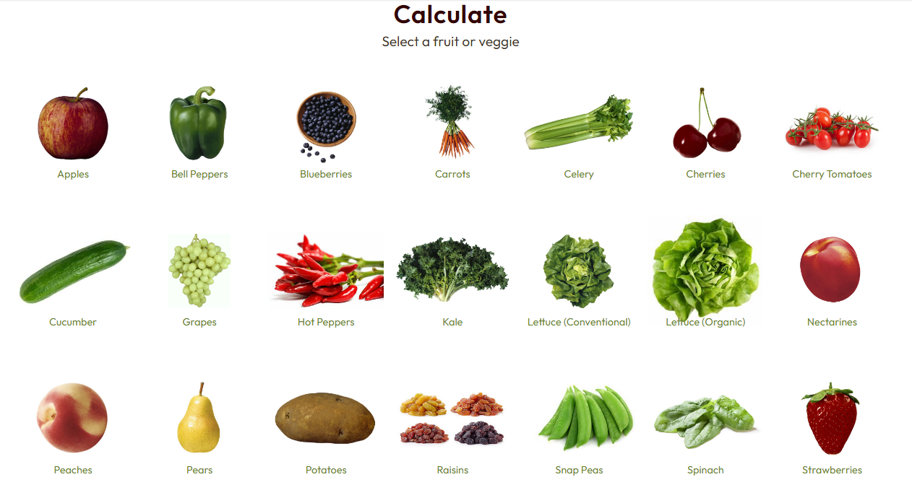

Slide 27
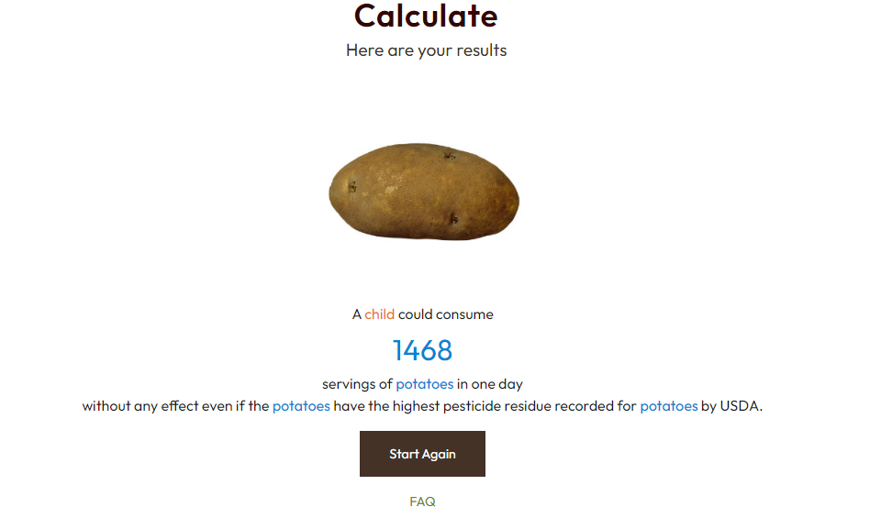

Slide 28
How much do I have to eat to “get sick?”
 |  | Max PDP | Residue | NOAEL Dose | Servings equivalent to NOAEL
Commodity | EWG Rank | Residue | (ppm) | (mg/kg-bw/day) | Child | Teen | Woman | Man
Apple | 4 | Diphenylamine | 4.2 | 10 | 340 | 680 | 850 | 1,190
Celery | 9 | Dicloran | 1.5 | 50 | 7,843 | 15,686 | 19,608 | 27,451
Cucumbers | 13 | Oxamyl oxime | 1.7 | 0.1 | 12 | 24 | 30 | 42
Peach | 5 | Iprodione | 7.2 | 100 | 1,890 | 3,779 | 4,724 | 6,614
Potato | 12 | Chlorpropham | 23 | 250 | 1,469 | 2,938 | 3,672 | 5,141
Strawberries | 1 | Captan | 7.5 | 10 | 181 | 363 | 454 | 635
Sweet bell peppers | 11 | Acephate | 1.5 | 0.5 | 78 | 157 | 196 | 275
$$Serving equivalent=\frac{NOAEL (\frac{mg}{kg}) x Body Weight \left(kg\right) x 1000 }{ residueppm \left(ppm\right) x Serving size (g)}$$
From R. Krieger, UC Riverside
Perspective on Pesticide Residues in Fruits and Vegetables

Slide 29
Is there any harm in the Dirty Dozen?
1 in 10 Americans
↑ fruits and veggies (FV) = ↓ cancer risk
Fear-based messaging deters FV consumption
Nutrition Today 51(5):242-250
FV “prescriptions” could prevent cardiovascular disease and death
PLOS Medicine (https://doi.org/10.1371/journal.pmed.1002761)
Science Daily, 10 June 2019 (www.sciencedaily.com/releases/2019/06/190610100624.htm)

Slide 30
Toxicity Values of Common Products
Pesticide | LD50 (ppm) |  | Product | LD50 (ppm)
Aldicarb | 0.8 |  | Capsaicin | 47
Diazinon | 300 |  | Caffeine | 200
Copper sulfate | 300 |  | Ethylene glycol | 460
Ridomil Gold SL | 550 |  | Benadryl | 500
 |  |  | Flonase | 1000
Malathion | 1000 |  | Acetylsalicylic acid | 1000
Atrazine | 1780
 |  |  | Amoxycillin | 2870
 |  |  | Sodium chloride | 3320
Glyphosate | 4300 |  | Accutane | 4000
Phosphorous acid | >5000

Slide 31
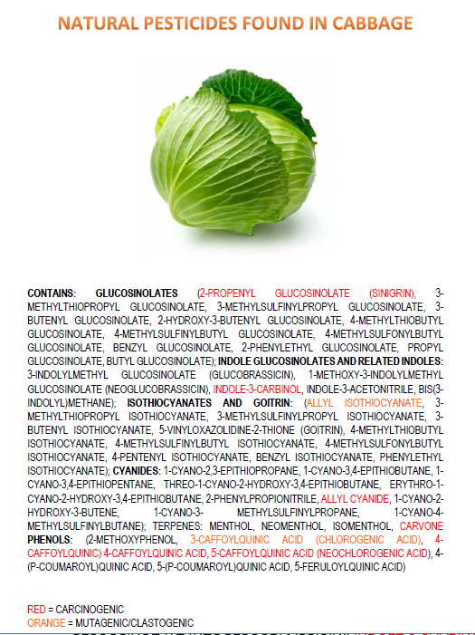
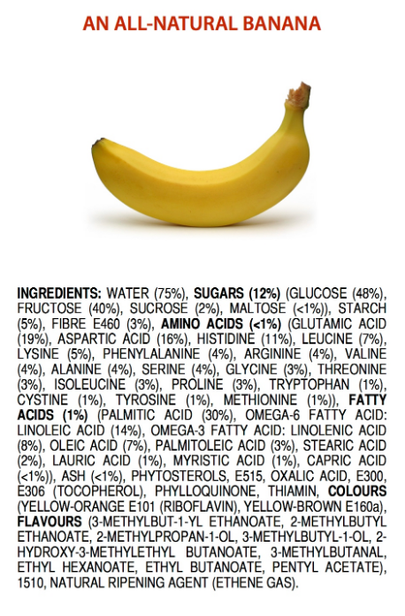
https://jameskennedymonash.wordpress.com/category/infographics/

Slide 32
So what do I do now?
Always follow the label!
Use pesticides responsibly.
Speak up in defense of agriculture.
Our food production system is a great story.
Don’t be afraid of your conventionally produced food.

Slide 33
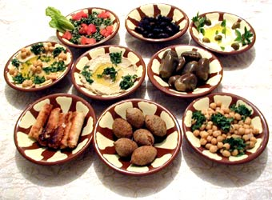
African Proverb
“Well fed people have many problems,
hungry people have just one.”

Slide 34
Good luck in 2024!
From The Far Side, Gary Larson

