Slide 1
Prepping Your Seed for Optimum Performance
Dr. Jeff Miller
Trent Taysom, Cheryn Suarez
Scott Anderson, Dr. Terry Miller

Slide 2
Miller Research – Rupert, ID
Contract efficacy and GLP research
Established in 1975

Slide 3
Miller Research Outreach – www.MillerResearch.com

Slide 4
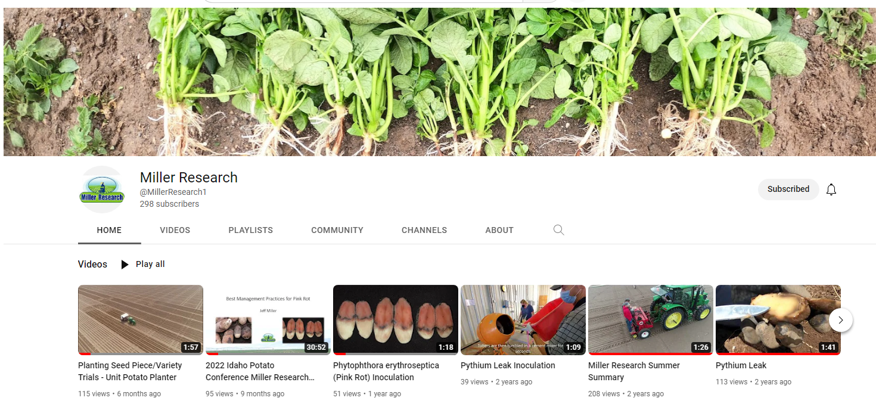
Miller Research Outreach – YouTube Channel

Slide 5
Additional Sources on Information
Facebook: Miller Research LLC
Twitter: @millerresearch
YouTube: @MillerResearch1
LinkedIn: Miller Research
Instagram: miller.research
Google Groups (Email): Idaho Potato Pest Resource
www.MillerResearch.com

Slide 6
The Far Side
From The Far Side, Gary Larson

Slide 7
How do I get optimum performance from my seed?
Select high quality seed
Sanitize equipment and storages
Sharpen cutter blades
Use an effective seed piece treatment
Suberize seed properly
Proper soil temperature and moisture at planting

Slide 8
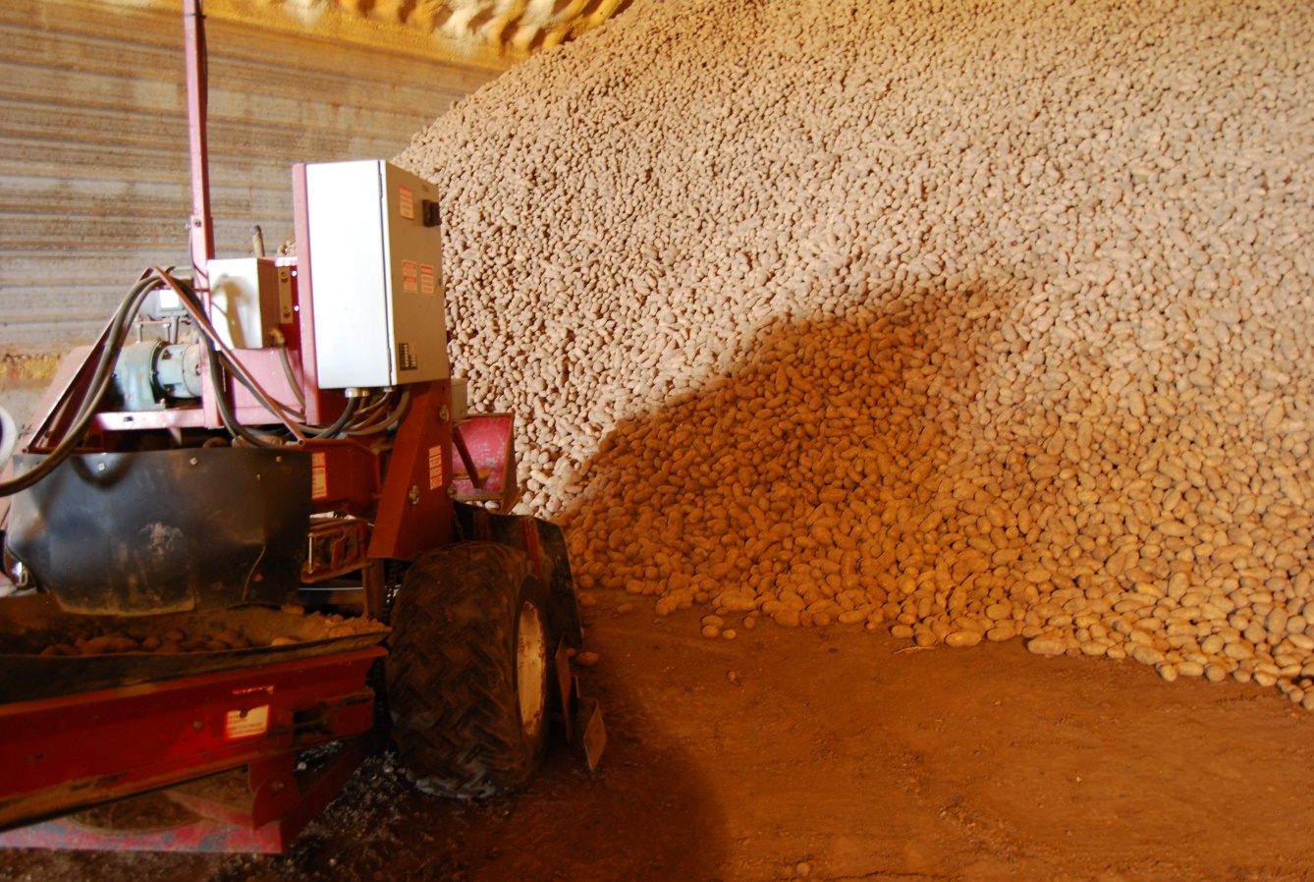
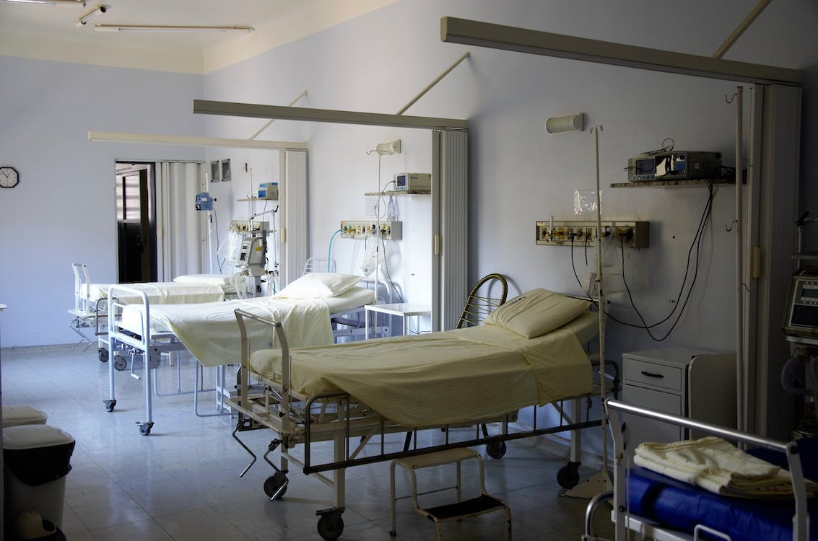
1. Select high quality seed
“A potato storage is not a hospital.” - Walt Sparks

Slide 9
What makes high quality seed?
Not physiologically aged
Related to stress, not the calendar
Disease-free (if possible)
Proper storage
34-38°F (2-4°C)
High humidity

Slide 10
Physiological Age
Younger Seed
Older Seed
Slower emergence
Fewer stems (sprouts/eye)
Fewer tubers/plant
Longer canopy life
Larger-sized tubers
Later tuber initiation
Faster emergence (4-5 days)
Multiple stems (sprouts/eye)
Increased tubers/plant
Earlier tuber initiation
Smaller-sized tubers
Earlier senescence
Adapted from Iritani et al., 1972; in Potato Production Systems (2020), p. 149

Slide 11
Seed Size and Physiological Age on Emergence

Slide 12
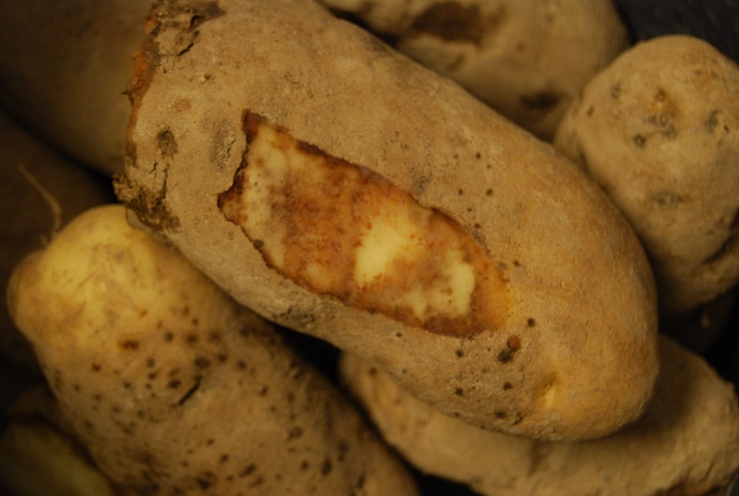
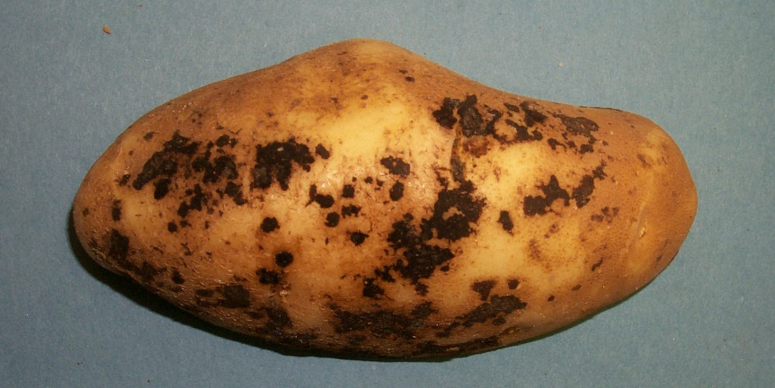
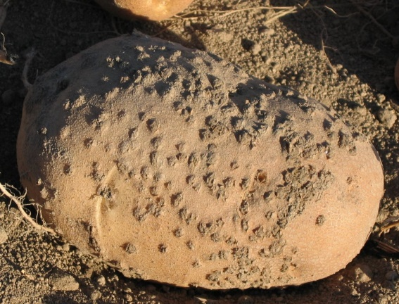
Disease-Free Seed
Bacterial ring rot
Mosaic viruses
Late blight
Fusarium dry rot
Rhizoctonia
Powdery scab

Slide 13
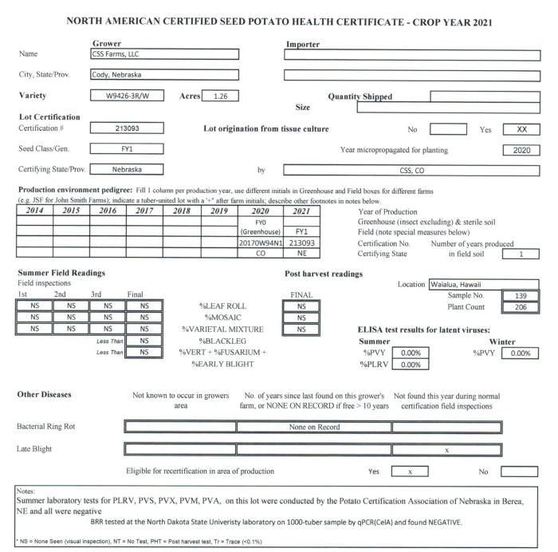
North American Plant Health Certificate
PLRV
Mosaic
Blackleg
Verticillium + Fusarium
Early blight
Bacterial ring rot
Late blight

Slide 14
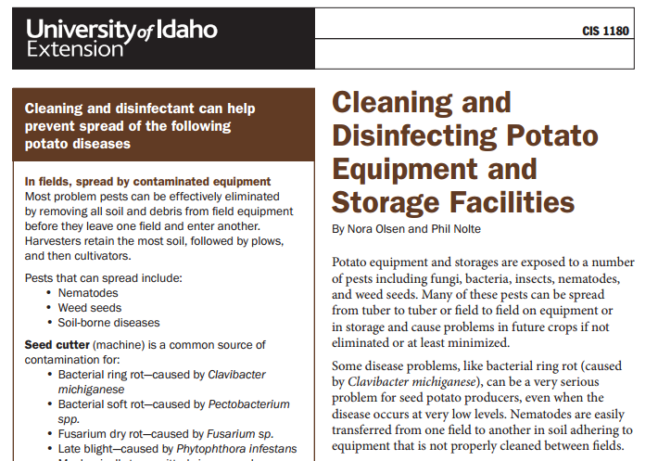
2. Sanitize equipment and storages
Storage facilities
Truck beds
Seed cutters
Potato handling equipment
U of I CIS 1180

Slide 15
Cleaning/Disinfecting Storage
Remove plant debris/foreign material
Dirt floors: remove 1-2 inches and replace with non-potato soil
Wash entire facility – soap and hot water, then rinse
Apply disinfectant – wet for 10-15 minutes
Na, Ca, or NH₄ hypochlorite
Chlorine dioxide
Quaternary ammonium compounds
Hydrogen peroxide/peroxyacetic acid mixtures

Slide 16
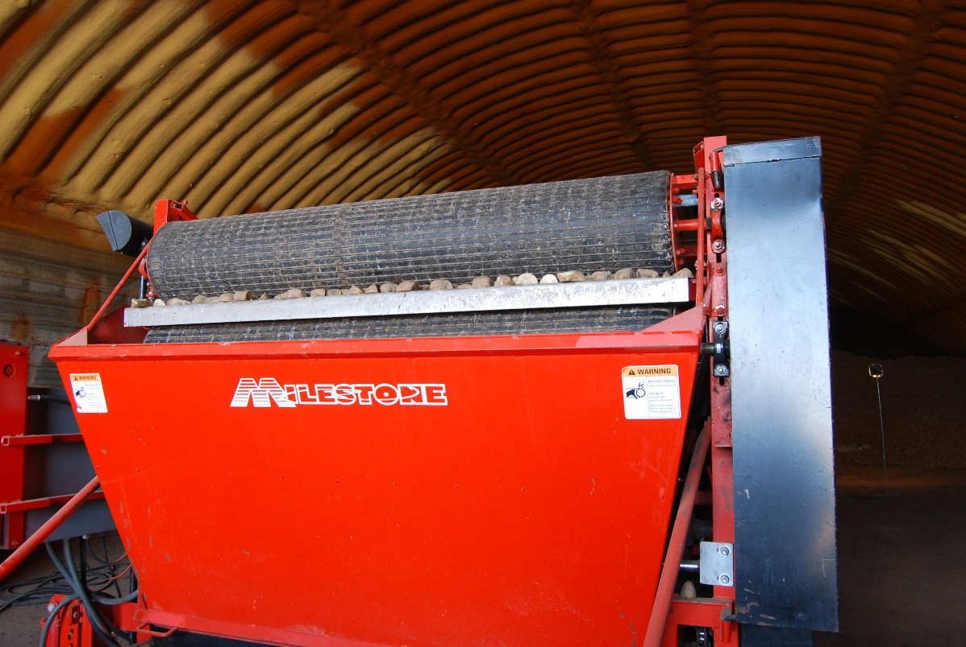
Seed Cutter Contamination
Bacterial ring rot
Bacterial soft rot
Fusarium dry rot
Late blight
Mechanically transmitted viruses
E.g. PVX
(Pick vs cup planters)

Slide 17
3. Sharpen seed cutter blades
Cleaner cut = less damage
Faster wound healing

Slide 18
4. Use an effective seed piece treatment

Slide 19
Managing Fungicide Resistance
FRAC = Fungicide Resistance Action Committee
Scientific effort aimed at prolonging fungicide efficacy
www.frac.info/home
Fungicides classified by mode of action (MoA)
Different products may have similar MoA

Slide 20
Selected Seed Treatment Options
Weak on Dry Rot
Resistance Concerns
Product | Form | M3 | 3 | 7 | 11 | 12 | 40
MZ Dust | Dust | X
STartUP MANZB | Liquid | X
Maxim 4 FS | Liquid |  |  |  |  | X
Maxim MZ | Dust | X |  |  |  | X
Moncoat MZ | Dust | X |  | X
CruiserMaxx Potato | Liquid |  |  |  |  | X
Spirato | Liquid |  |  |  |  | X
STartUP FLUDI | Liquid |  |  |  |  | X
CruiserMaxx Potato Extreme | Liquid |  | X |  |  | X
CruiserMaxx Potato Vibrance | Liquid |  | X | X |  | X
Emesto Silver | Liquid |  | X | X
Salient | Liquid |  | X
Vibrance Ultra Potato | Liquid |  | X | X |  |  | X
Reason 500 SC | Liquid |  |  |  | X

Slide 21
Selected Seed Treatment Options
Product | Form | Fus. Dry Rot | Rhizoctonia | Silver Scurf | Late Blight
MZ Dust | Dust | MZ |  |  | MZ
STartUP MANZB | Liquid | MZ |  |  | MZ
Maxim 4 FS | Liquid | fludi | fludi | fludi
Maxim MZ | Dust | fludi + MZ | fludi | fludi
Moncoat MZ | Dust | MZ | flutolanil | flutolanil
CruiserMaxx Potato | Liquid | fludi | fludi | fludi
Spirato | Liquid | fludi | fludi | fludi
STartUP FLUDI | Liquid | fludi | fludi | fludi
CruiserMaxx Potato Extreme | Liquid | fludi + difen | fludi | fludi + difen
CruiserMaxx Potato Vibrance | Liquid | fludi + difen | fludi + sed | fludi + difen
Emesto Silver | Liquid | pen + proth | penflufen | pen + proth
Salient | Liquid | difen |  | difen
Vibrance Ultra Potato | Liquid | difen | sed | difen | mandi
Reason 500 SC | Liquid |  |  |  | fenamidone

Slide 22
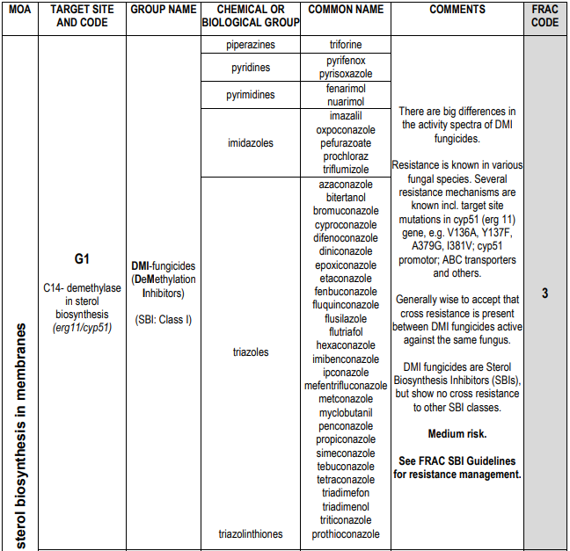
3

Slide 23
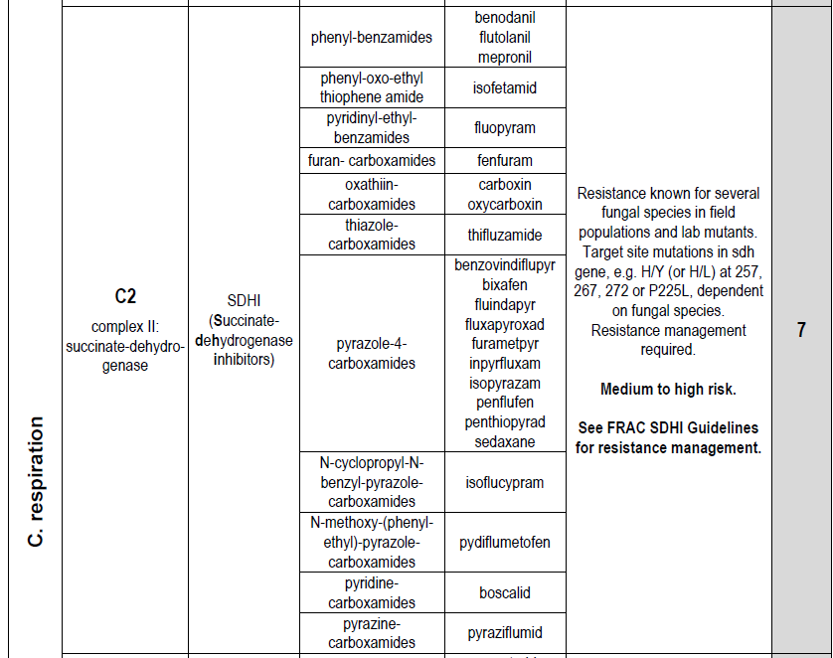
7

Slide 24
Fusarium Dry Rot Incidence - 2021 Clearwater Russet

Slide 25
Fusarium Dry Rot Incidence - 2022 Clearwater Russet

Slide 26
Fusarium Dry Rot Incidence (%) Clearwater Russet
CMV = CruiserMaxx Vibrance, 0.5 fl oz/cwt

Slide 27
5. Suberize properly
Suberization = formation of a protective layer of cells on cut seed surface
Takes 2-4 days to complete the first layer
50-55°F
Plenty of oxygen, high RH
Pile seed no more than 6 feet high
Plant within 3-4 days, or after 14 days
5-14 days after cutting, the seed is susceptible to damage

Slide 28
6. Proper soil temperature and moisture
Soil and seed temperature should be similar
50-55°F (10-13°C) ideal
75-85% available soil moisture
Good seed in wet soil can favor bacterial soft rot
From “Checklist of Potato Emergence Problems”, NDSU Extension

Slide 29
Potato Emergence Problems

Slide 30
How do I get optimum performance from my seed?
Select high quality seed
Sanitize equipment and storages
Sharpen cutter blades
Use an effective seed piece treatment
Suberize seed properly
Proper soil temperature and moisture at planting

