Slide 1
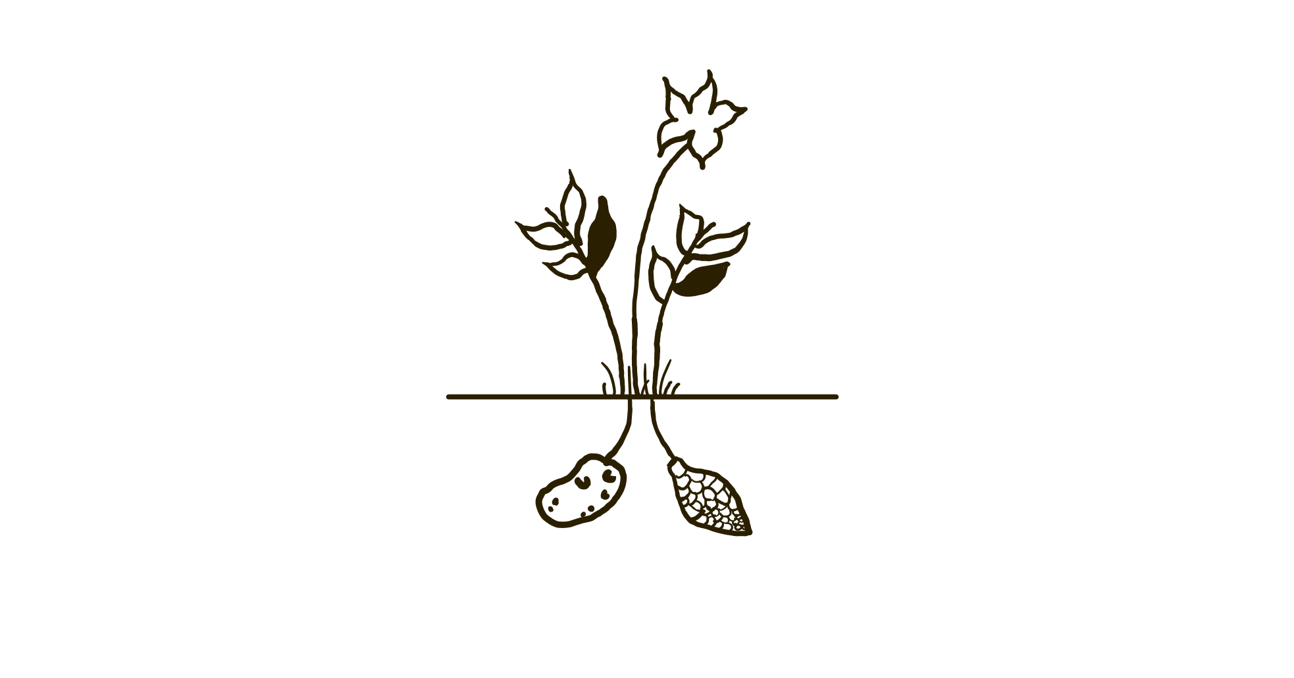

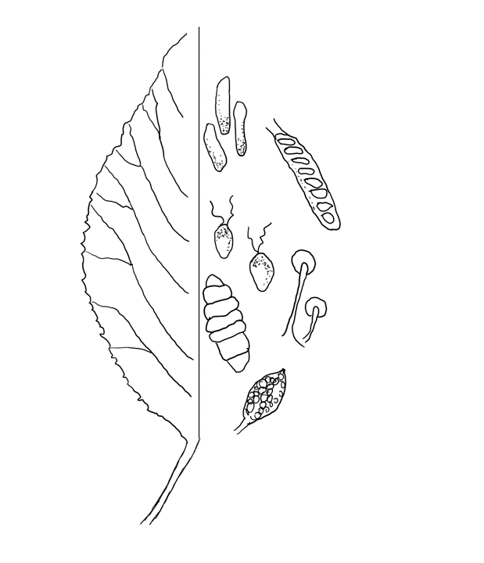
2021 Maine Potato Conference
Managing Potato Early Dying Using Soil Fumigation and Pesticides
Kedi (Cody) Li, graduate student
Jay Hao, Advisor
School of Food and Agriculture
University of Maine
Notes:
Hello everyone, welcome to my presentation, my name is Cody, I am a master student in University of Maine and work in Jay Hao’s lab. I am very glad to share the research progress of managing potato early dying using soil fumigation and pesticides.

Slide 2
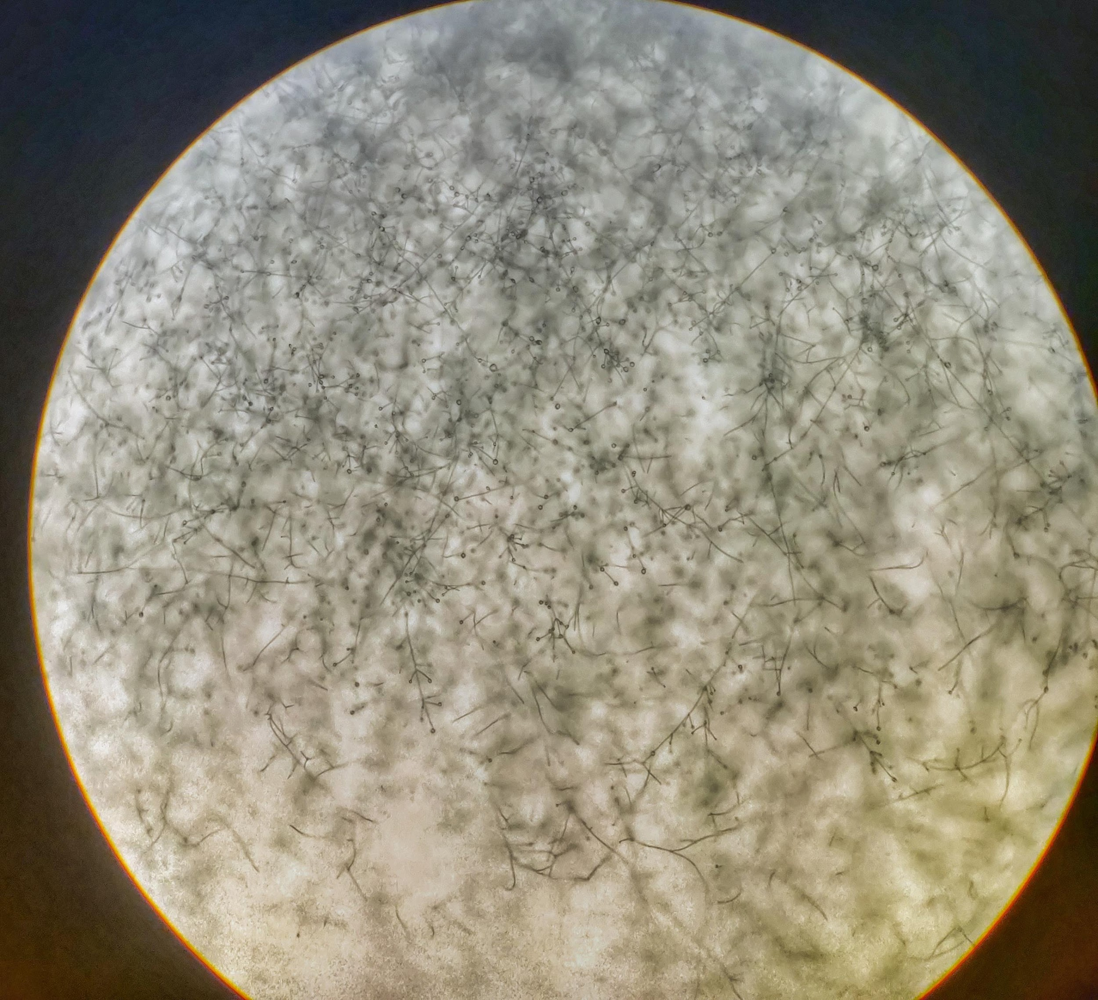
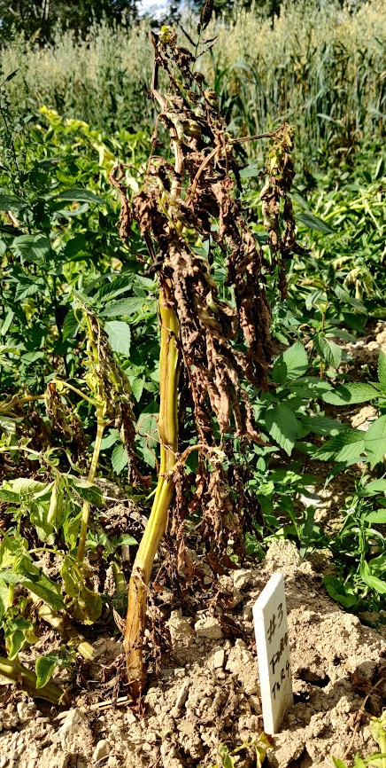
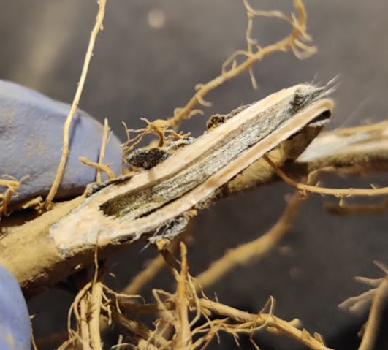
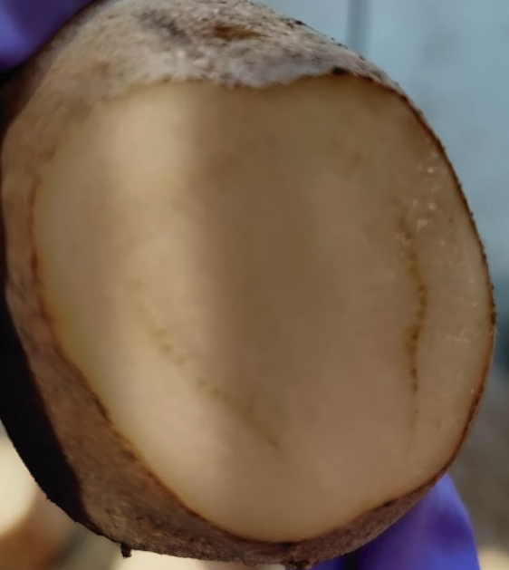
Potato early dying (PED)
Flagging
Wilt/dying
Vascular discoloration
Notes:
So first, I am goanna do a brief introduction of the background.
Potato early dying (abbreviate as PED), is one of the severest soil borne disease of potato. The yield loss caused by PED is typically ranged from 10% to 15%, and occasionally can reach up to 50%.
The symptom of an infected potato plant is standing up higher than the other plants in the field, its a condition called flagging. The seriously infected plants may completely wilt or dying.
Since the pathogen colonizes in the vascular system of plant, brown vascular discoloration can be observed in both stem and tuber. Like the figure on the right bottom.
When a plant is complete wilt or dying, you may find many little black dots colonized in the stem like the figure shows on right top

Slide 3
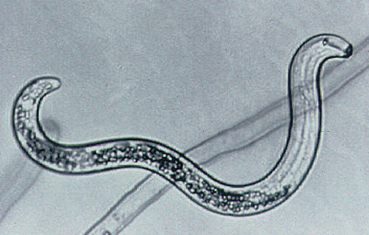
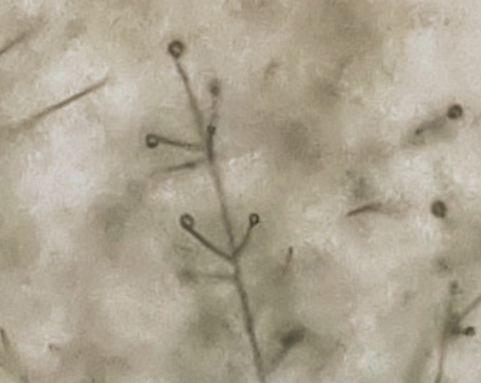
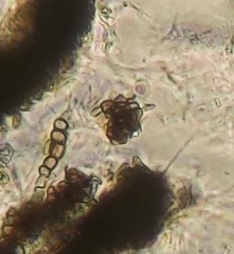
PED pathogen: Verticillium dahliae
          Interact with nematodes (Pratylenchus penetrans)
          Soilborne pathogen
          Long term of survival of microsclerotia
          Wide range of hosts
* P. Penetrans
Conidia & conidiophore
Microsclerotia
*P. Penetrans figure was from Flickr by Oregon State University at https://flickr.com/photos/33247428@N08/30640871652
Notes:
The pathogen causes potato early dying is Verticillium dahliae and exacerbated by Pratylenchus penetrans
as a soil borne pathogen, verticillium dahliae can stay viable in soil for over 14 years because of the survival structure—microsclerotia. as the figure on the left bottom. And it’s the black dot in last slide.
Once the environment is getting favorable for verticillium dahliae, microsclerotia are induced to germinate to form a large number of conidia and mycelia to start a new round of infection.
In addition, V. dahliae can affect over200 species of hosts.
As a consequent, Both the long-life span and wide range of hosts make potato early dying become extremely hard to control.
In this study, two field trial have been conducted for the evaluation of potato early dying chemical management.

Slide 4
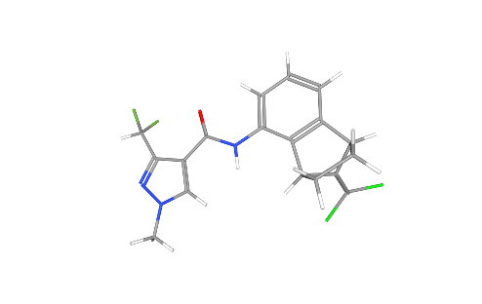





Chemicals
Commercial Name | Active ingredient | Mode of Action
Vapam | metam sodium | -
Aprovia | benzovindiflupyr | Succinate Dehydrogenase Inhibitor (SDHI)
Elatus | azoxystrobin + benzovindiflupyr | Quinone outside Inhibitors (QoI) + SDHI
 | Bacillus amyloliquefaciens | Antagonism, plant resistance inducing, plant growth promotion
 | Reynoutria sachalinensis | Systemic Acquired Resistance (SAR), Induced Systemic Resistance (ISR)
Notes:
Both fumigant and fungicide were studied. They all have been either proved to be effective on control of potato early dying or have potential to be effective.
The fumigant selected was Vapam, the active ingredient is metam sodium.
The fungicides selected include two respiration system inhibitor Aprovia and Elatus. And a biocontrol bacteria product Stargus and a plant extract product regalia.
The active ingredients are listed in yellow column, and the mode of actions are listed in the green column.
It’s noteworthy that Elatus has two different active ingredient, one is benzovindiflupyr, which is same as Aprovia. And another is azoxystrobin. The idea of having two different mode of actions is to get a better performance on avoiding or delaying the resistance.

Slide 5
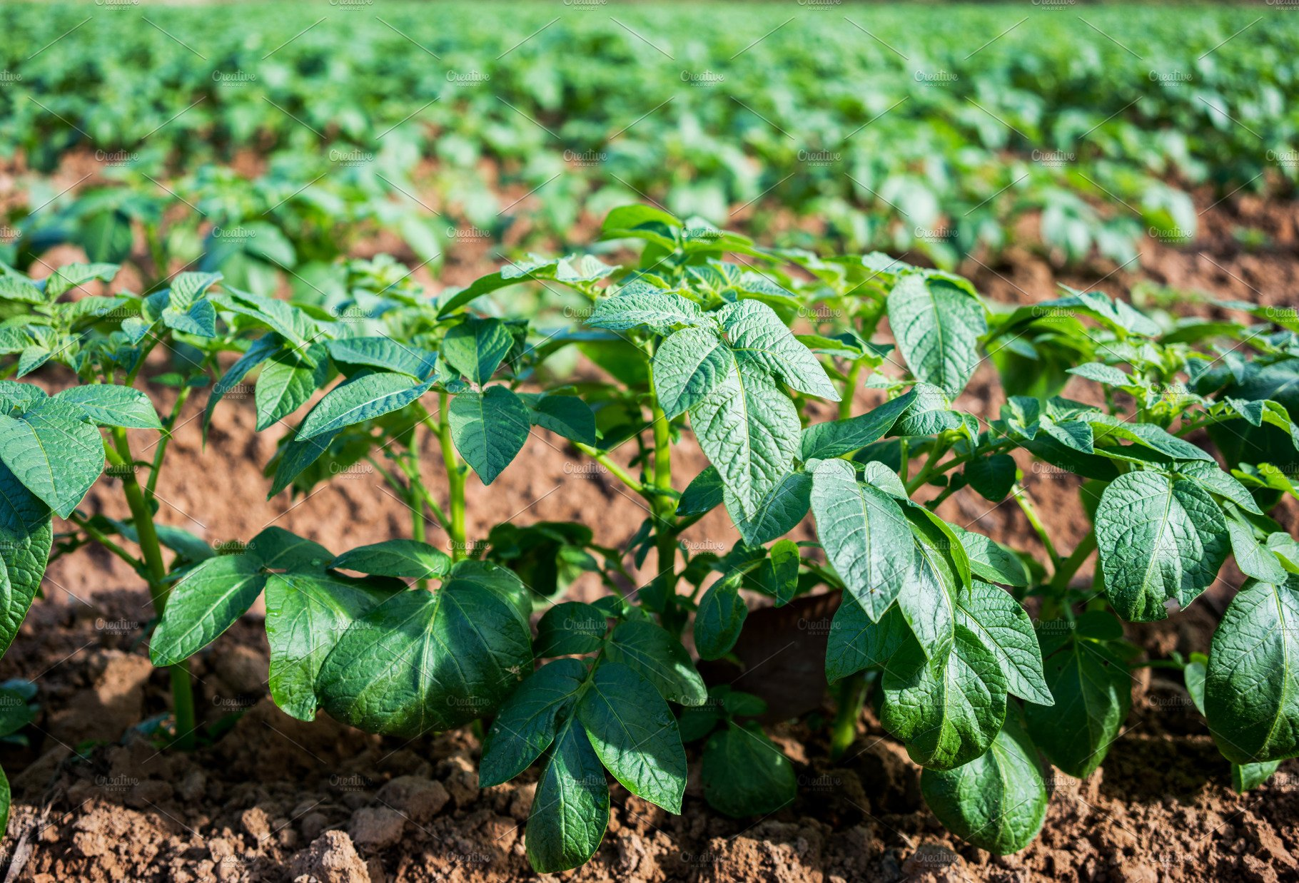
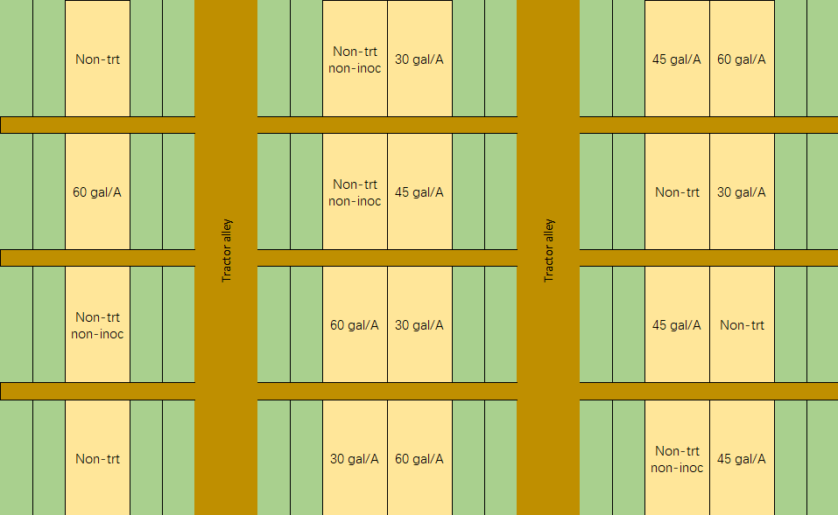
Fumigation field trial
V. dahliae Inoculum
@20g/foot
Potato variety: Russet Burbank
Notes:
The first field trial is fumigation. And the plot design is as the figure shows here;
This trial was assigned randomized complete block design with 5 treatments and 4 replications. The potato variety used was russet burbank
The treatments goes from left to right in this figure, (click) they were non-treated, non-treat non inoculated, and vapam at 3 different concentration, 35 gal/a, 45 gal/a, 50gal/a.
Except the non-inoculated plots, the verticillium dahlia was inoculated into each plot. The inoculum was prepared on oat seeds, 20 gram of inoculum was applied per foot in the row at planting.
The replication goes from top to bottom (click), it’s replicated 4 times.

Slide 6
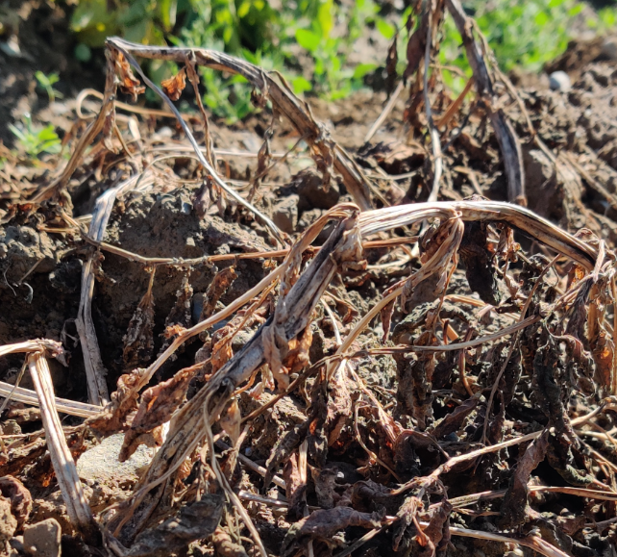
Disease evaluation
Pre-harvest
Post harvest
Wilted/dying plants
Vascular ring and brown area
Notes:
To study the effect of Vapam, the disease severity was investigated 2 weeks before harvest, the proportion of wilted plants and dying plants to the total number of plants were counted as disease incidence.
And post harvest, 50 tubers were cut, And the number of tubers with vesicular ring were compared with the total number of investigated tubers to calculate the disease incidence.
(click)

Slide 7
Fumigation trial 2020
NT: non-treated
NTNI: non-treated and non-inoculated
A
a
B
B
B
Disease incidence(%)
B
ab
ab
ab
b
Significance was determined by Student-Newman-Keuls test (α=0.05).
Notes:
This is the figure of disease evaluation result. The vapam at different dosage had suppressed the disease incidence significantly for on-tuber symptom. Which was as expected.
And the same trend was shown for on-plant symptom evaluation as well,
By comparing the non-treated non-inoculated plots with the 60 gal/a plots, you can see they are basically at the same level. And the disease incidence of 30 gal/a was slightly higher than 60gal/a, but, as said, they’re not statistically different.
So I would say according to the disease incidence of this trial, the 30 gal/a can be the best cost-efficient way of application. However, this should be further examined by the data from following year.

Slide 8
Fungicide field trial
Treatments | Time point | V. dahliae Inoculum
Elatus | At planting | 20 g/foot
Aprovia | At planting
Non-treated | NA
Non-treated | NA | NA
Stargus + Regalia | At planting and at emergence* | 20 g/foot
2020
2019
*: by different strategies
Notes:
Second part is pestcides evaluation, a two-year project was conducted. In 2019, 4 treatments were applied. Include Elatus, Aprovia, non-treated and non-treated non-inoculated. The inoculum for first three treatments was oatseeds with verticillium grown on.
In 2020, in addition to the mentioned 4 treatments, stargus and regalia was applied.

Slide 9
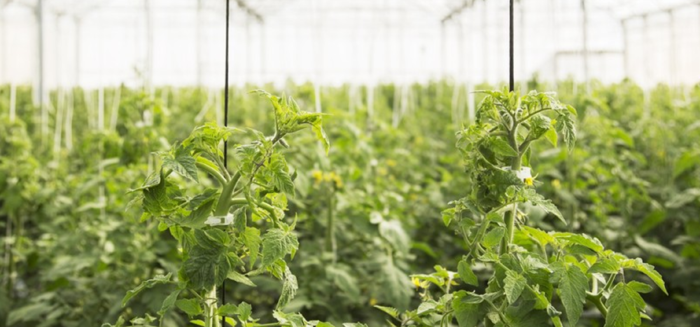
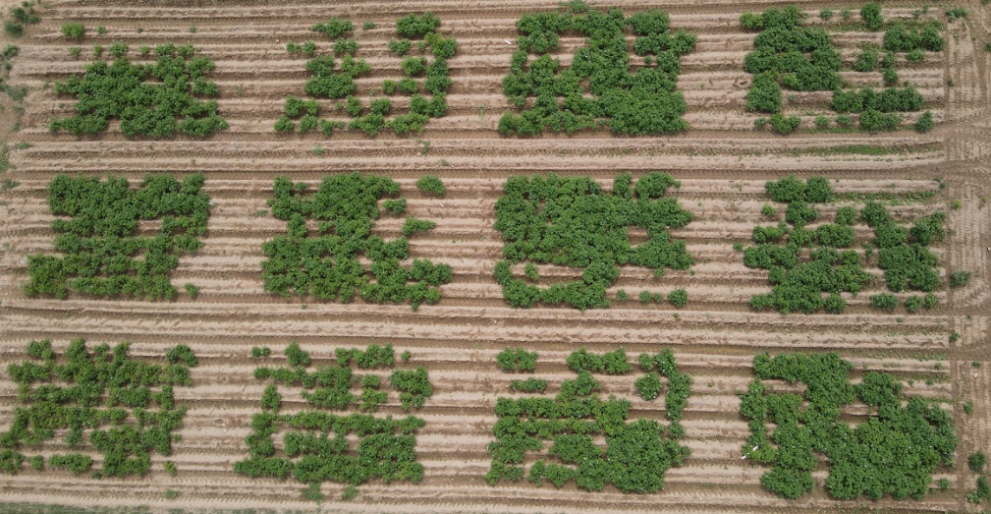
Field trial
NTNI
V. dahliae Inoculum @20g/foot
Potato variety: Superior
NT
SRS
SRR
Aprovia
Elatus
*Photo was taken at 2 months after planting
*SRS: Stargus + Regalia at planting, Stargus at emergence
SRR: Stargus + Regalia at planting, Regalia at emergence
Notes:
Because the 2020 trial had two more treatments than 2019, it’s more representative. So I listed a real field picture that was taken two months after planting to show the plot design. (click)
The plot was arranged with randomized complete block design as well. And the potato variety used was superior.
Different treatments were masked with different colors(click). Red is elatus(click). , brown is Aprovia(click x2). , yellow is Stargus and regalia at planting, and apply Stargus again when emergence(click). , green is Stargus and regalia at planting and apply regalia again when emergence(click). . Blue is non treated (click). and purple is non inoculated non treated
For some reasons, the edge rows on the top didn’t grow well. But we can still see the trend: the elatus, Stargus, and regalia treated plot had an overall better growth than other plots. Like ….(use pointer)
And the Aprovia treated plots had a relative low emergence rate as the brown area shows here (use pointer)

Slide 10
Result of Field trial 2019
a
ab
ab
Disease incidence(%)
Total yield (cwt/A)
b
A
A
A
A
*NT: non-treated
NTNI: non-treated and non-inoculated
Significance was determined by Student-Newman-Keuls test (α=0.05).
Notes:
Move to the result, the on-plant disease evaluation was done by the same method as the fumigation trial. And the on-tuber evaluation method was calculating the percentage of diseased area for 2019 trial. And comparing the number of tuber with vesicular ring was compared with the total number of investigated tubers to calculate the disease incidence for 2020 trial.
These figures are the result of 2019 field trial, statistically saying, both Elatus and Aprovia could suppress the on-plant disease symptom to the same level as non-treated non-inoculated plots.
Comparing those two pesticides, the elatus treated plots disease incidence was a little bit lower then Aprovia treated plots, despite they’re not statistically different.
The same trend presented on tuber evaluation as well, but the data was not significant for all treatments.
And for the yield. although the Elatus treated plot resulted in the highest yield among all the treatments, they were not statistically different, which was consistent with the tuber disease incidence.

Slide 11
Result of Field trial 2020
A
B
B
a
ab
B
B
Total yield (cwt/A)
Disease incidence(%)
ab
ab
ab
B
*SRS: Stargus + Regalia at planting, Stargus at emergence
SRR: Stargus + Regalia at planting, Regalia at emergence
NT: non-treated
NTNI: non-treated and non-inoculated
Significance was determined by Student-Newman-Keuls test.
Notes:
The result of 2020 experiment had the same trend as 2019. start at the left figure, The on-plant disease incidence was suppressed by pesticides application significantly. Although the data was not statistically different among all pesticides treated plots, you can still visually see the SRS, which was apply Stargus twice and regalia once, and SRR, which was apply Stargus once and regalia twice, those two treatments presented the lowest on-plant disease incidence.
Also, the same trend was shown in tuber evaluation, the only difference was the lowest on-tuber disease incidence was shown in Elatus treated plots.
For the on-tuber disease, (click) only non-treated plot showed significant higher value but the trend was the same.
Then move to the figure on the right, the plots applied Stargus twice and regalia once showed the highest yield, which was consistent with the disease evaluation data.
But the interesting thing was even though the Aprovia can significantly suppress the disease symptom on plant, it got the lowest yield again, same as 2019.

Slide 12
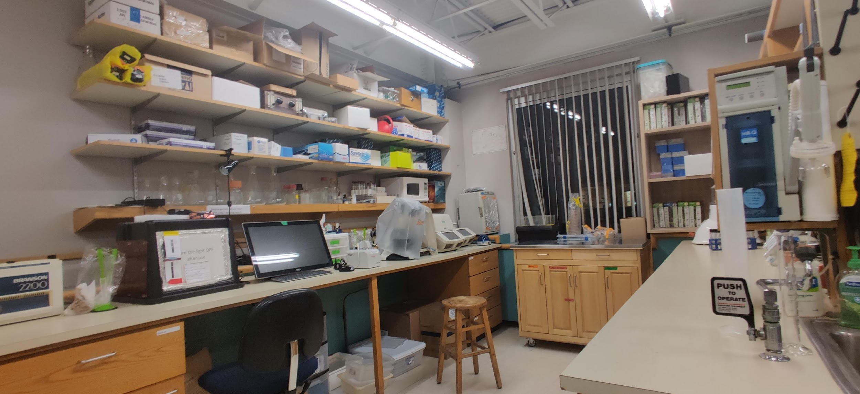
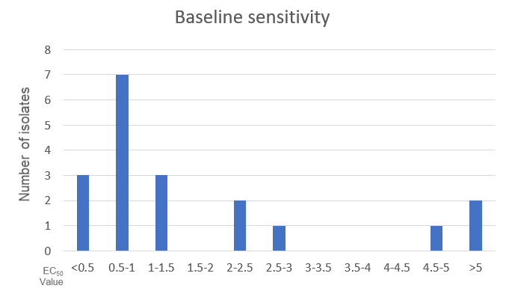
Sensitivity of V. dahliae to benzovindiflupyr (a.i. of Elatus and Aprovia)
EC₅₀ Values （ug/ml)
Notes:
In addition to the field trial, the sensitivity of 19 natural verticillium dahliae isolates to benzovindiflupyr was investigated. This is the shared active ingredient of Aprovia and elatus.
The sensitivity was evaluated by effective concentration of 50% inhibition (EC50) value.
The EC50 values of those 19 isolates were distributed from 0.1 to about 8 microgram/ml. As you can see in this figure, most of them are less than 3, and a few of them are greater than 4.5. There is a gap can be seen between 3 to 4.5. so those isolates are basically separated into two clusters, the highest one is even 80 times higher than the lowest one. Which means it’s possible that the natural isolates of verticillium dahliae might have already obtained the resistance against benzovindiflupyr. As a consequence, the performance of products which use benzovindiflupyr as active ingredient might be affected.

Slide 13
Conclusion and discussion
All Aprovia, Elatus, Stargus, Regalia, and Vapam significantly suppressed plant symptom.
Vapam @ >35 gal/A was effective.
The mix of Stargus and Regalia worked the best, followed by Elatus;
The resistance of benzovindiflupyr should be considered.
Yield response is not significantly affected at lower disease pressure.
Notes:
Because each of field trials were conducted independently, I think the inoculum needs to colonize more in the soil, so the reduction of yield may be seen in the following year if we do the experiment at the same field.

Slide 14
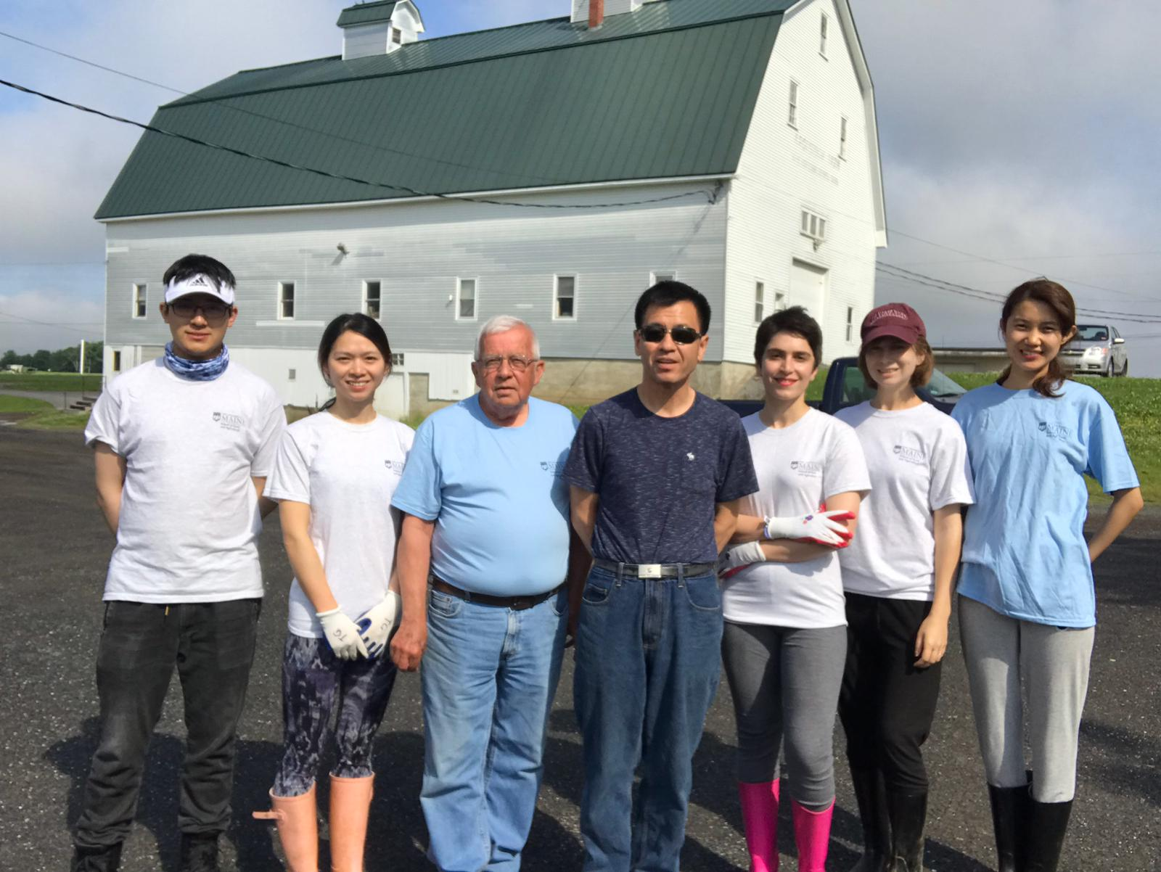
Acknowledgements
Dr. Steven Johnson
Aaron Buzza
Elbridge Giggie
Dr. Jianjun (Jay) Hao
Dr. Robert P. Larkin
Dr. Alicyn Smart
Hao Lab students
AMVAC Chemical Corporation
Maine Potato Board
Fatemeh
Sylvia
Cody
Tongling
Jay
Elbridge
Andrea
Notes:
At last, I would deeply appreciate Dr Johnson for leading the fumigation project and appreciate Aaron Buzza for the fumigant application.
Besides, sincerely appreciate Elbridge Giggie for the field operation support.
I would also thank my thesis committee Dr. Larkin, Dr. Smart, and Chair supervisor Dr Hao
This project is partially supported by AMVAC chemical corporation and Maine potato board. So, thank you very much!
Also, thank all my colleagues, tongling, sylvia, Fatemeh and andrea.

Slide 15
THANKS!

